Slide 1


Mitigating Bias in Adaptive Data Gathering via Differential Privacy
Seth Neel
Aaron Roth
ICML 2018 STOCKHOLM
University of Pennsylvania

Slide 2
What is adaptively gathered data?
The choice of whether to collect more data points of a given type depends on the data already collected
Often done via Bandit Algorithms
Recommender Systems for News , Clinical Trials, Potentially More High Stakes Applications (say child welfare hotline responses or predictive policing)
Beyond decision making, adaptively gathered data is often subsequently analyzed

Slide 3
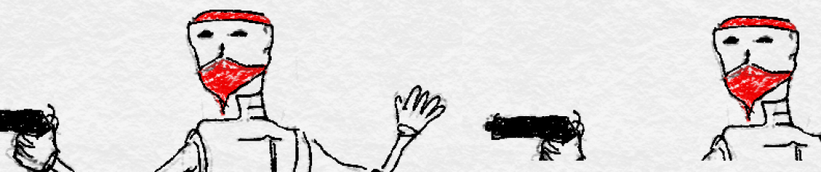
Bandit Algorithms Lead to Bias!
‘Why Adaptively Gathered Data Have Negative Bias and How to Correct for It’ [Nie, Tian, Taylor, Zou 17] shows that data gathered by bandit algorithms exhibits negative bias
This is due to a one-sided feedback loop:
  arms with low empirical means do not get pulled often on a relative basis (and stay low), while those with high empirical means do (and mean revert)
heuristic algorithm for recovering de-biased estimates: no formal guarantees
  Complicated optimization algorithm
  Requires noise addition

Slide 4
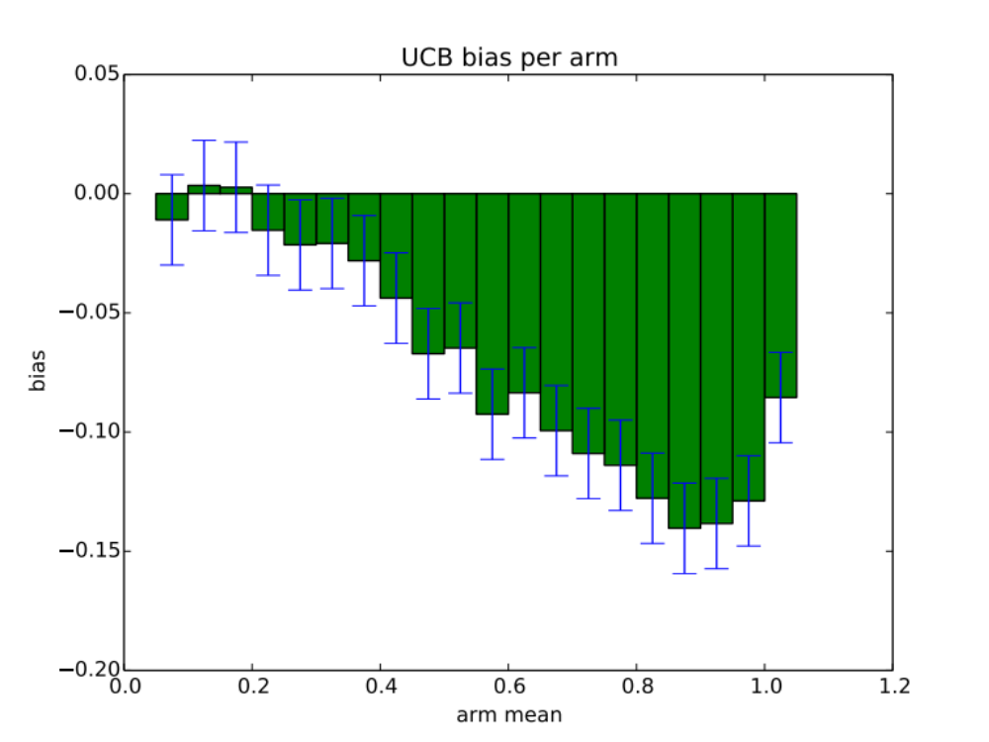
Bias is significant in practice!

Slide 5
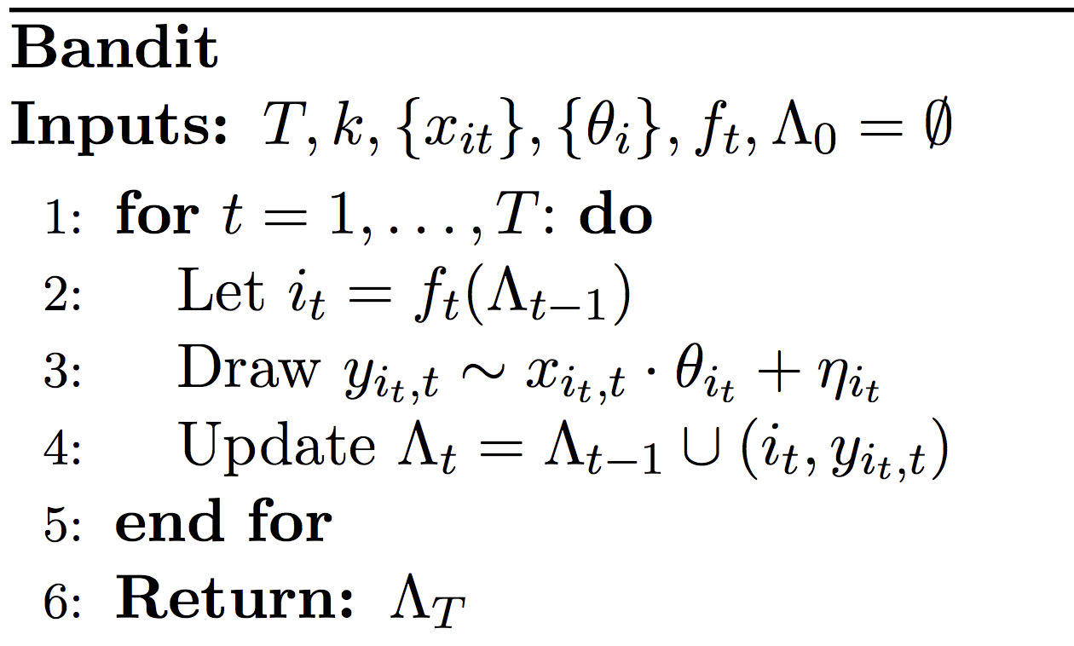
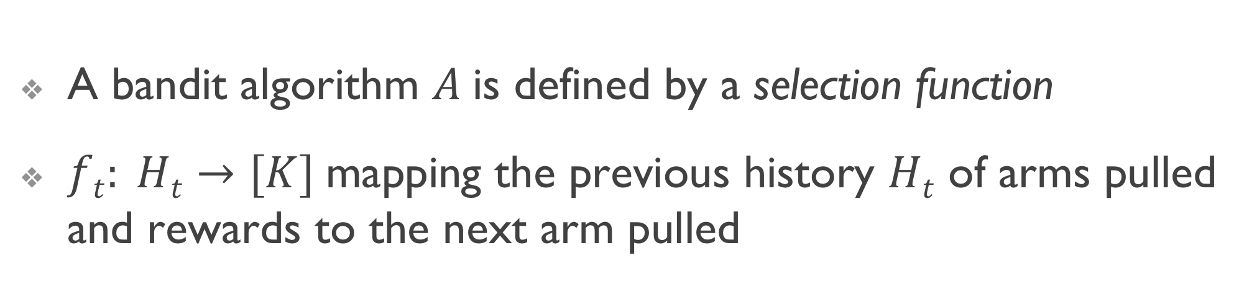
Bandit Algorithms: Definition 1
A bandit algorithm $A$is defined by a selection function
$ft: Ht→[K]$mapping the previous history $Ht$ of arms pulled and rewards to the next arm pulled

Slide 6
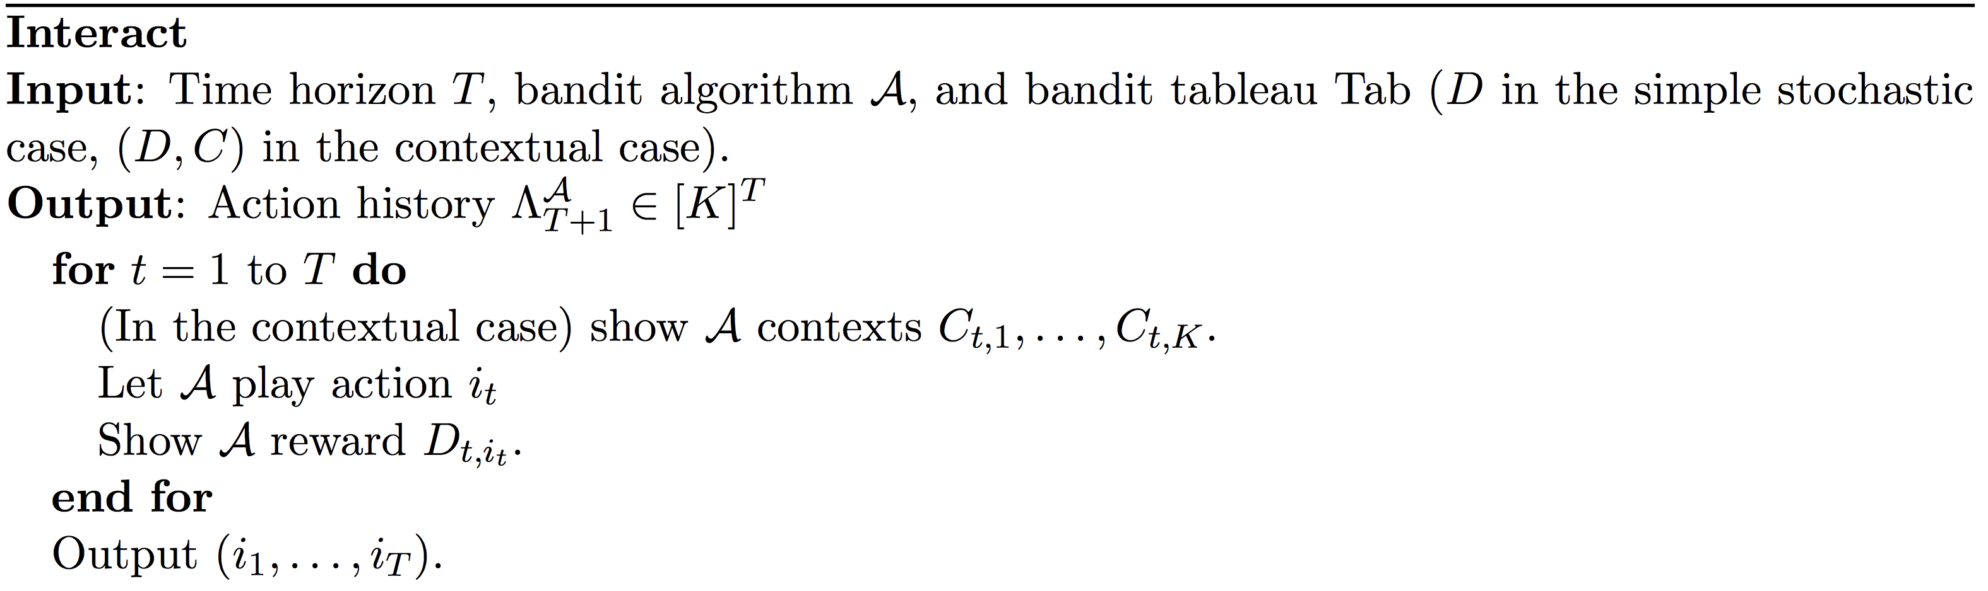
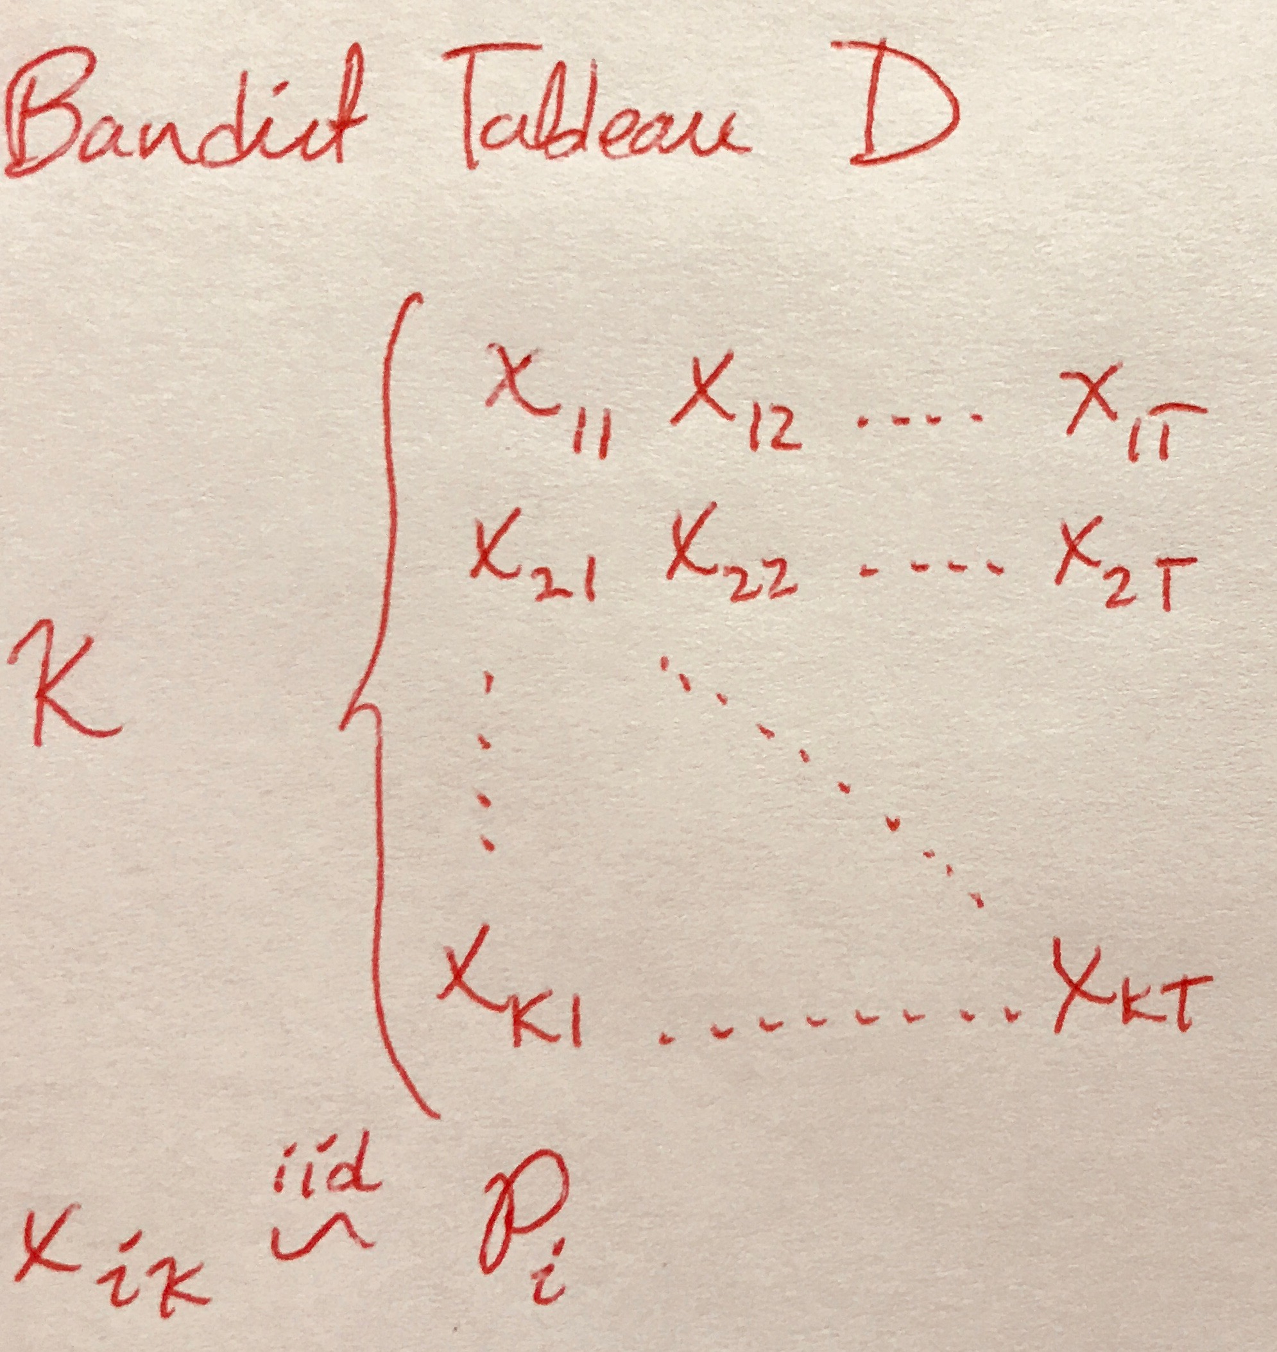
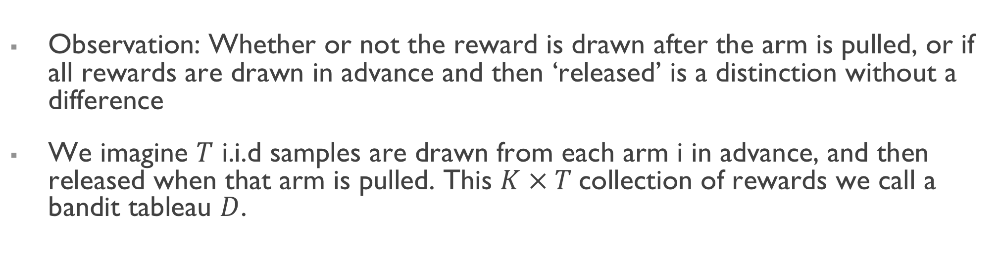
Bandit Algorithms: Definition 2
Observation: Whether or not the reward is drawn after the arm is pulled, or if all rewards are drawn in advance and then ‘released’ is a distinction without a difference
We imagine $T$ i.i.d samples are drawn from each arm i in advance, and then released when that arm is pulled. This $K × T$collection of rewards we call a bandit tableau $D$.

Slide 7
A motivating question:
Does Differential Privacy Reduce Bias in Adaptively Gathered Data?
What is the cost to accuracy (regret)?

Slide 8
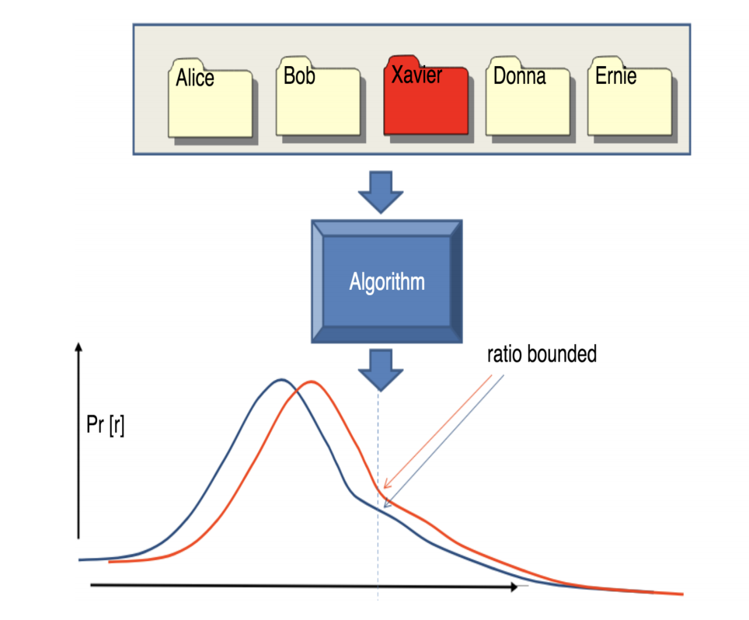
What is Differential Privacy?
Differential Privacy means that the distribution on outcomes is (nearly) unchanged whether Xavier’s record is included in the dataset or not.

Slide 9
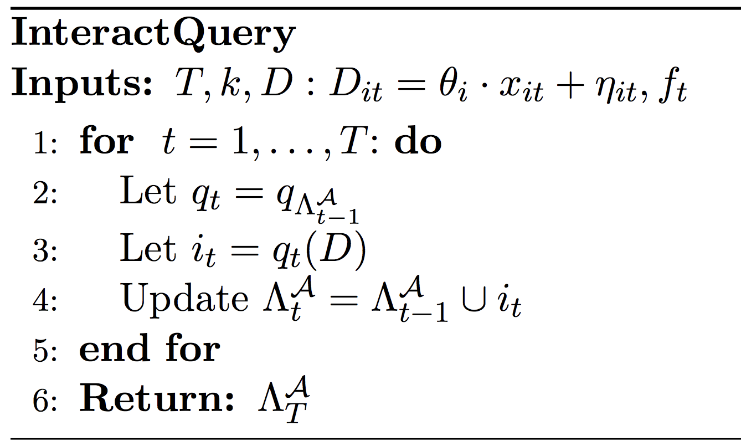

Bandit Algorithms as Query Release
Database is the bandit tableau D
The query at round t asks which arm to pull at round t+1 (is a function of the data)
Bandit algorithm can be modeled as a sequence of queries where q_{t} is only a function of the subset of D that has been “seen” by the algorithm
Hence all standard results in adaptive data analysis carry over!

Slide 10
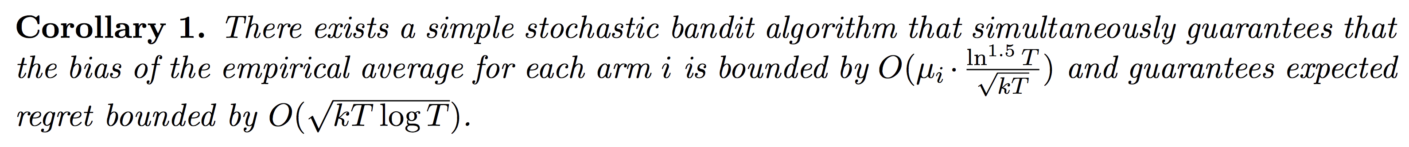
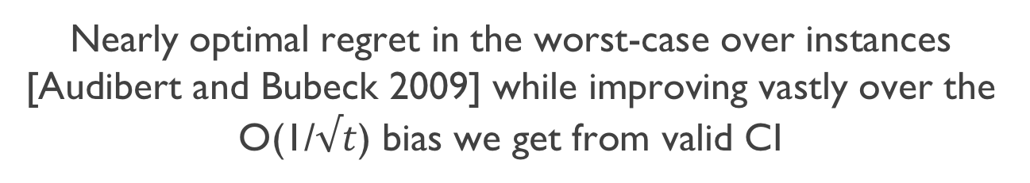
Balancing Accuracy and Bias
There exist differentially private algorithms that obtain a near optimal tradeoff between privacy and regret (see e.g. Tossou & Dimitrakakis 2016]
Applying the above theorem with their regret bounds gives:
Nearly optimal regret in the worst-case over instances [Audibert and Bubeck 2009] while improving vastly over the O(1/$√t$) bias we get from valid CI

Slide 11
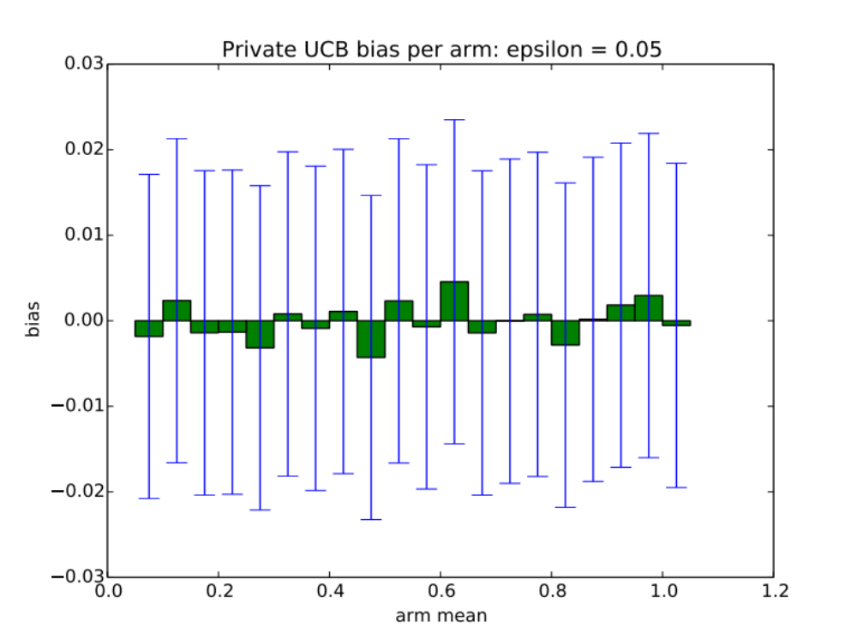
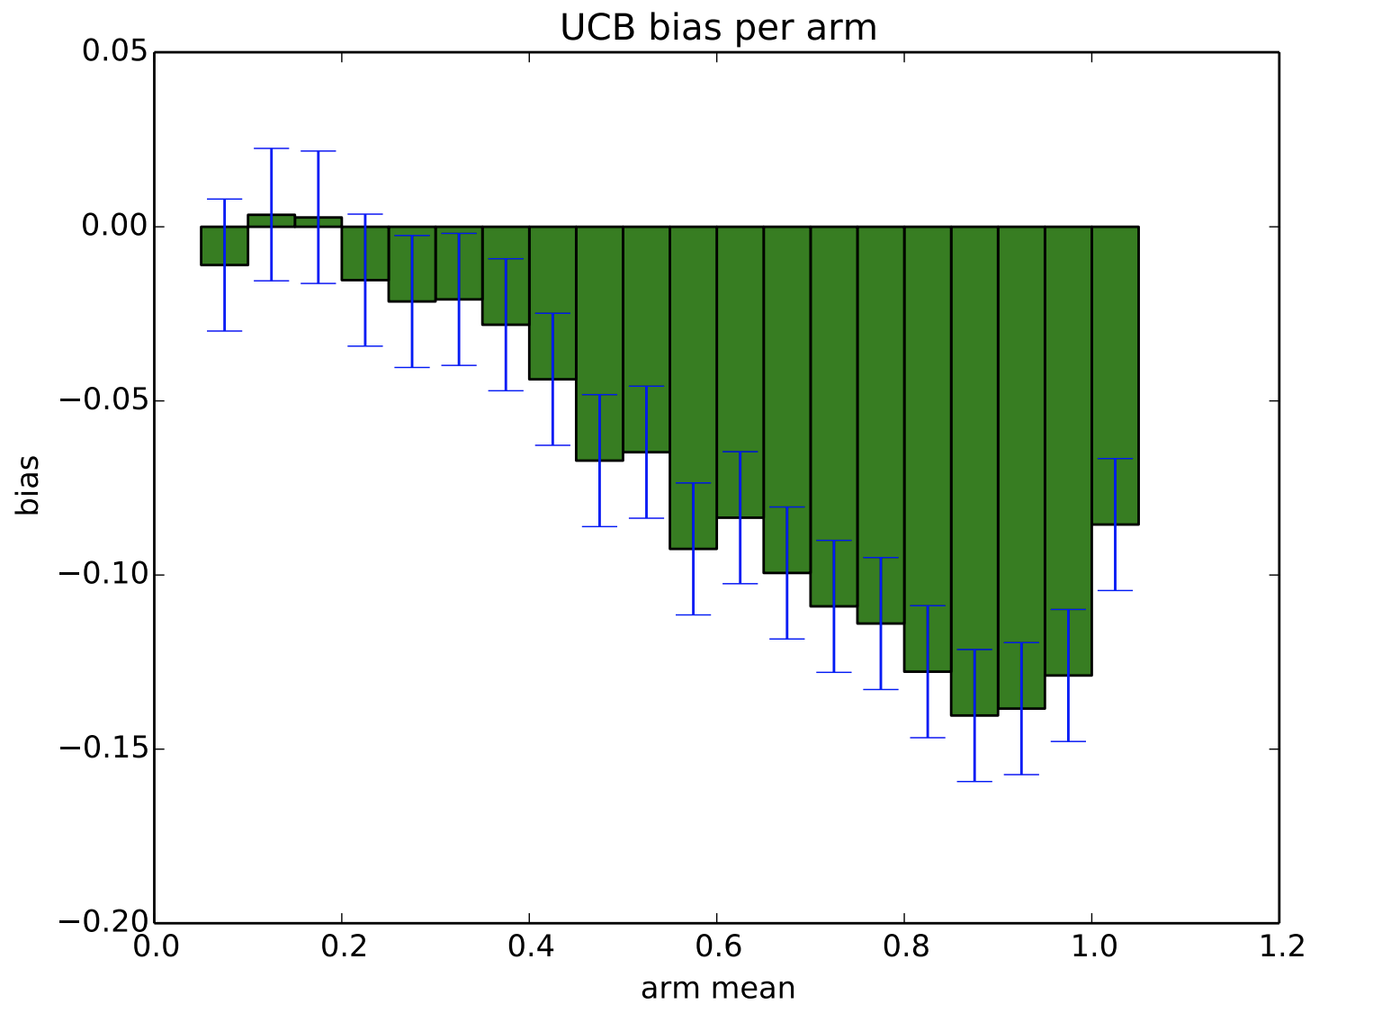
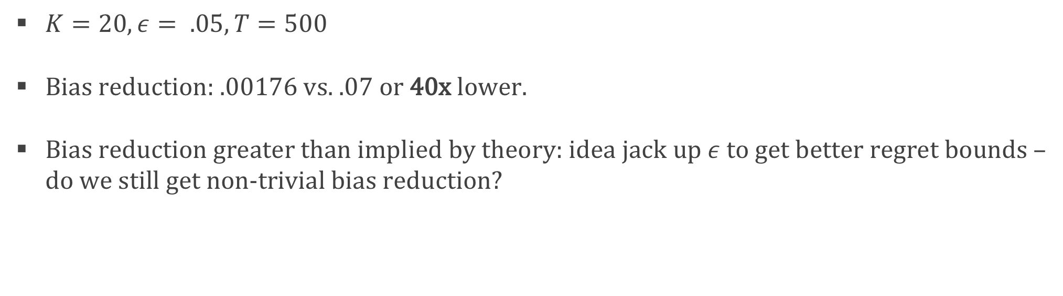
Experiments
$K=20, ε= .05, T=500$
Bias reduction: .00176 vs. .07 or 40x lower.
Bias reduction greater than implied by theory: idea jack up $ε$to get better regret bounds – do we still get non-trivial bias reduction?

Slide 12
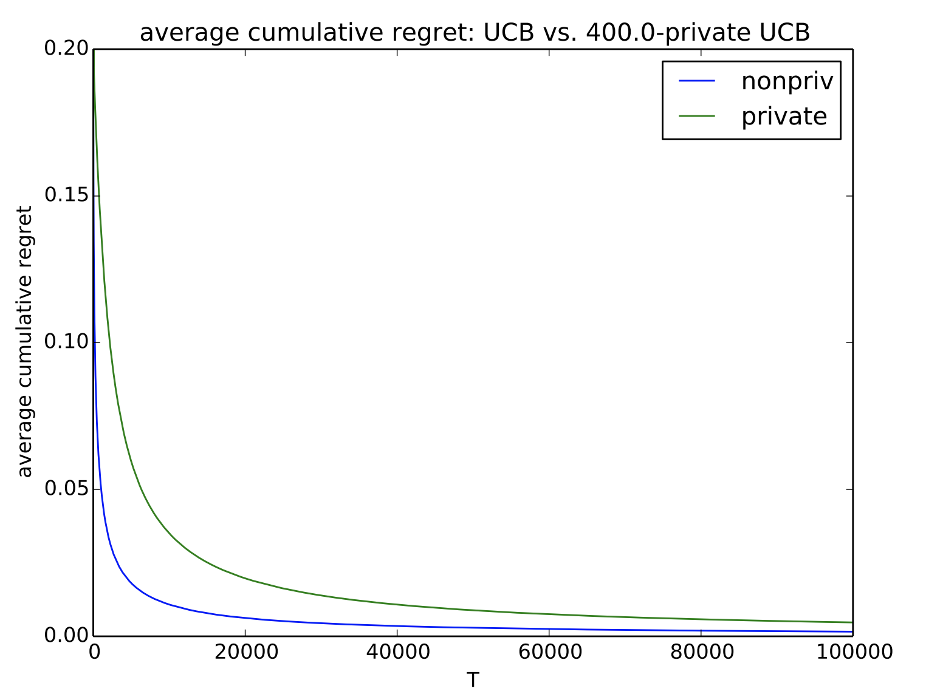
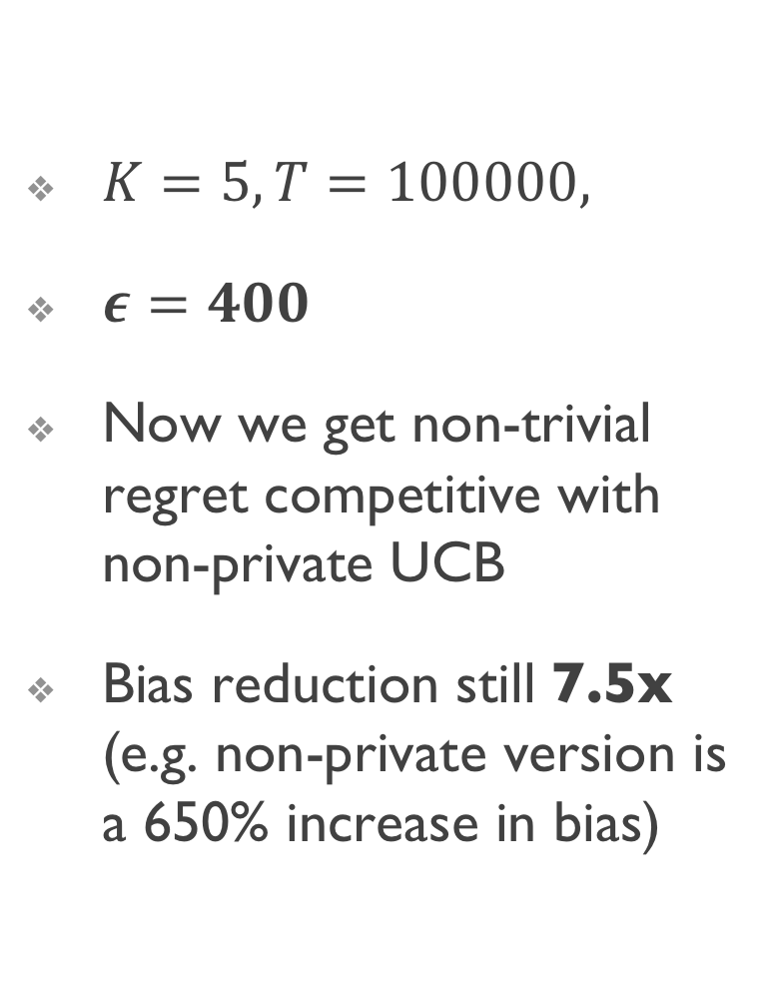
Experiment 2
$K=5, T=100000,$
$ε=400$
Now we get non-trivial regret competitive with non-private UCB
Bias reduction still 7.5x (e.g. non-private version is a 650% increase in bias)

Slide 13
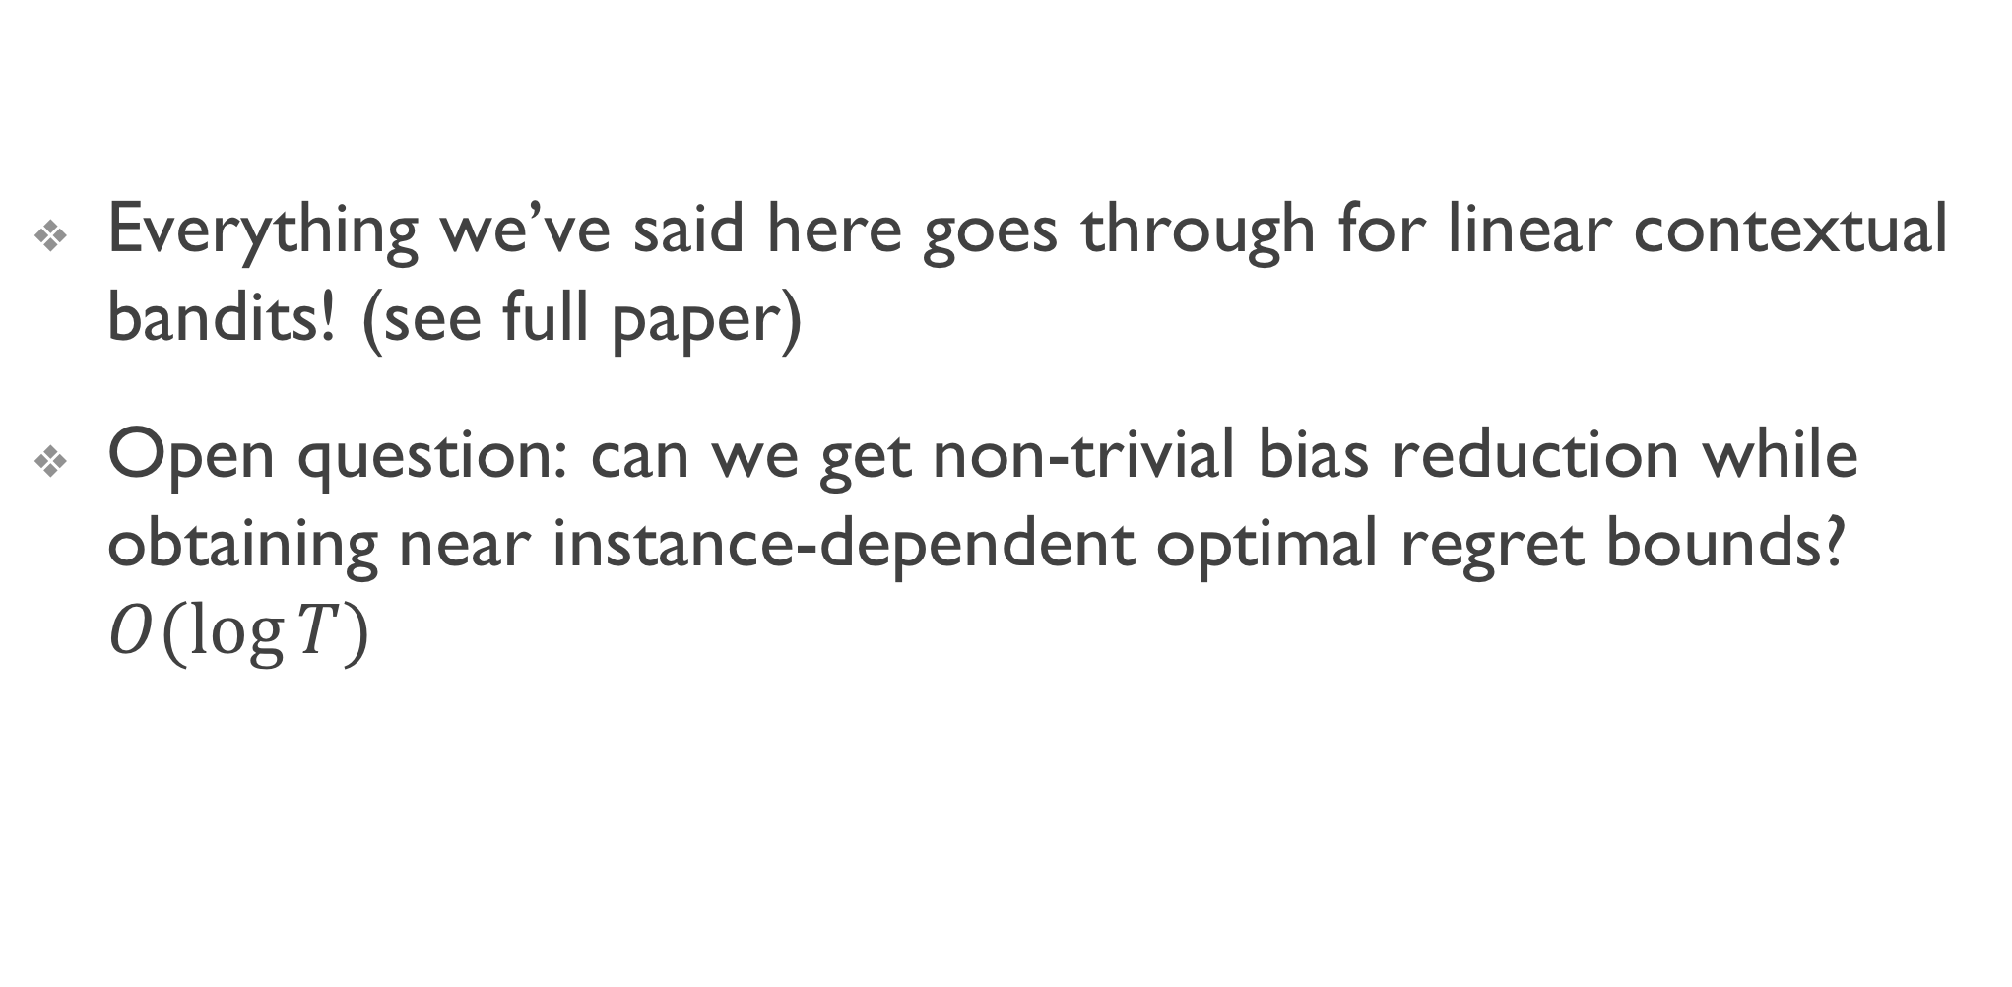
The End
Everything we’ve said here goes through for linear contextual bandits! (see full paper)
Open question: can we get non-trivial bias reduction while obtaining near instance-dependent optimal regret bounds? $O(log⁡T)$

