Slide 1


Mitigating Bias in Adaptive Data Gathering via Differential Privacy
Seth Neel
Aaron Roth
ICML 2018 STOCKHOLM
University of Pennsylvania

Slide 2
What is adaptively gathered data?
The choice of whether to collect more data points of a given type depends on the data already collected
Often done via Bandit Algorithms
Recommender Systems for News , Clinical Trials, Potentially More High Stakes Applications (say child welfare hotline responses or predictive policing)
Beyond decision making, adaptively gathered data is often subsequently analyzed

Slide 3
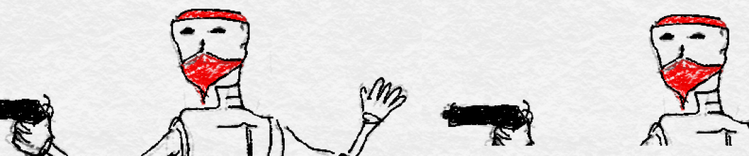
Bandit Algorithms Lead to Bias!
[Nie et al. 2017] shows that data gathered by bandit algorithms exhibits negative bias
This is due to a one-sided feedback loop:
  arms with low empirical means do not get pulled often on a relative basis (and stay low), while those with high empirical means do (and mean revert)
heuristic algorithm for recovering de-biased estimates: no formal guarantees
  Complicated optimization algorithm
  Requires noise addition

Slide 4
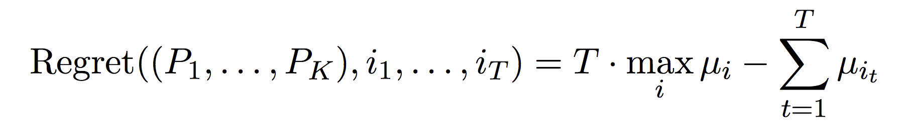
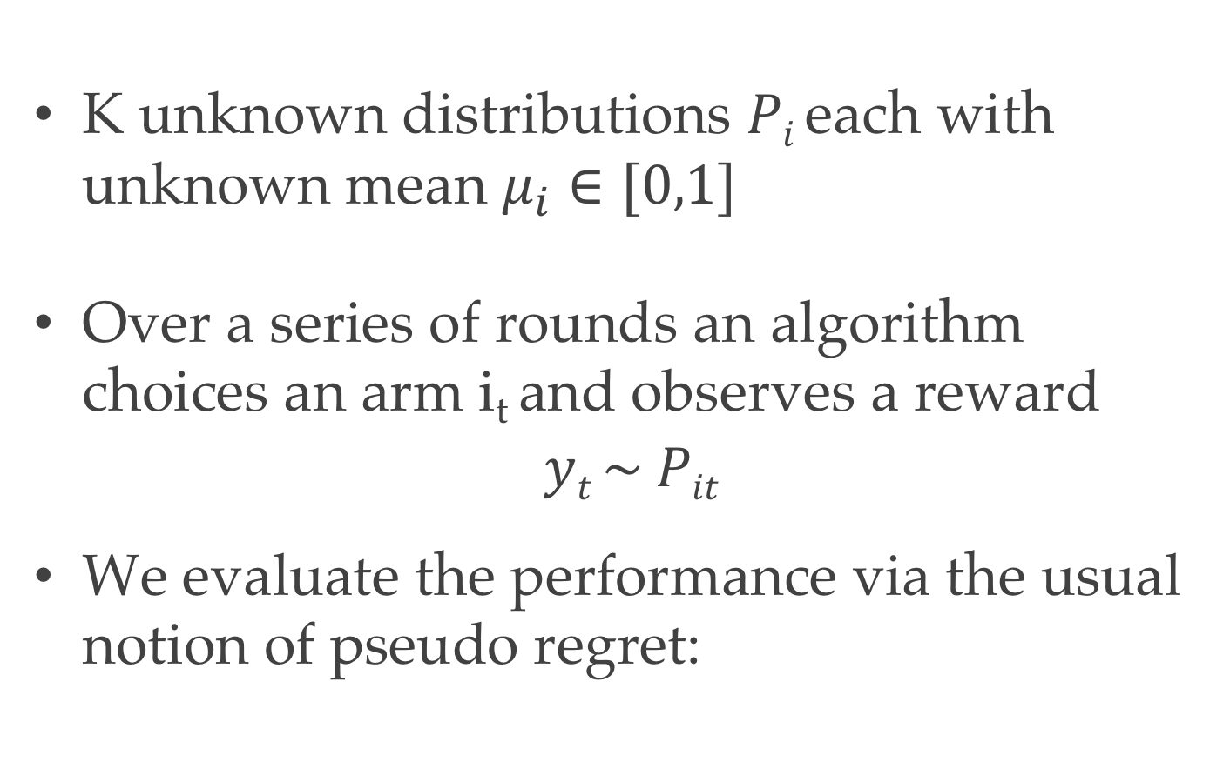
Simple Stochastic Bandits
K unknown distributions $Pi$each with unknown mean $μ_{i}∈[0,1]$
Over a series of rounds an algorithm choices an arm i_{t} and observes a reward
$$yt \sim Pit$$
We evaluate the performance via the usual notion of pseudo regret:

Slide 5
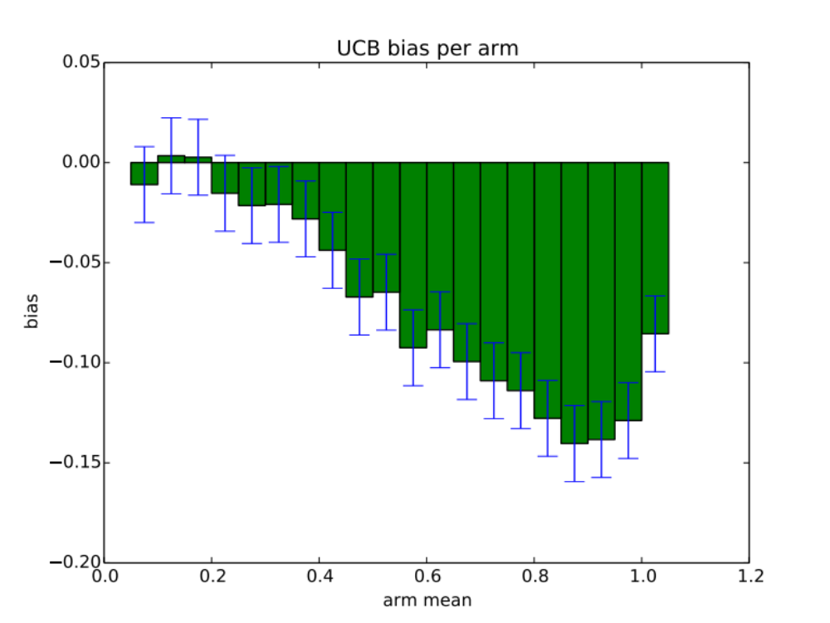
Bias is significant in practice!

Slide 6
A motivating question:
Does Differential Privacy Reduce Bias in Adaptively Gathered Data?
What is the cost to accuracy (regret)?

Slide 7
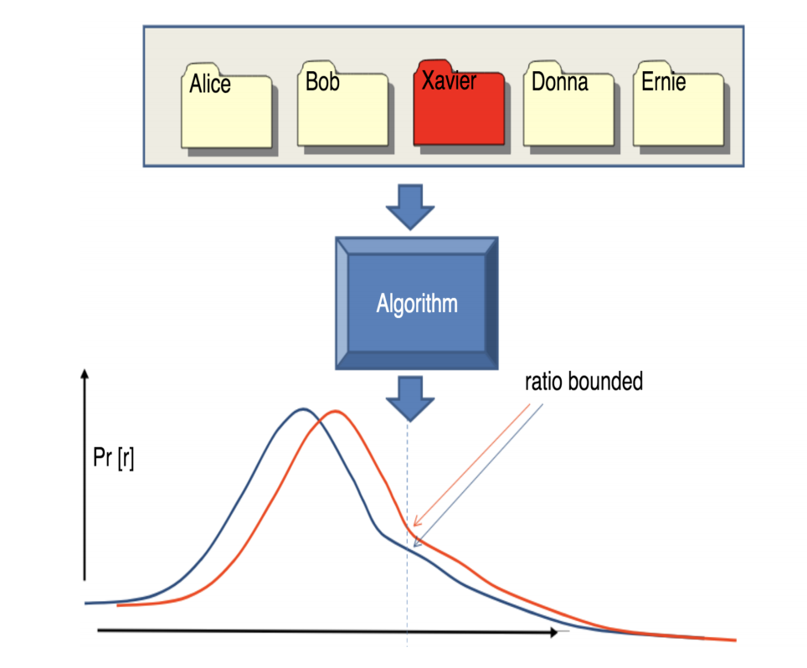
What is Differential Privacy?
Differential Privacy means that the distribution on outcomes is (nearly) unchanged whether Xavier’s record is included in the dataset or not.

Slide 8
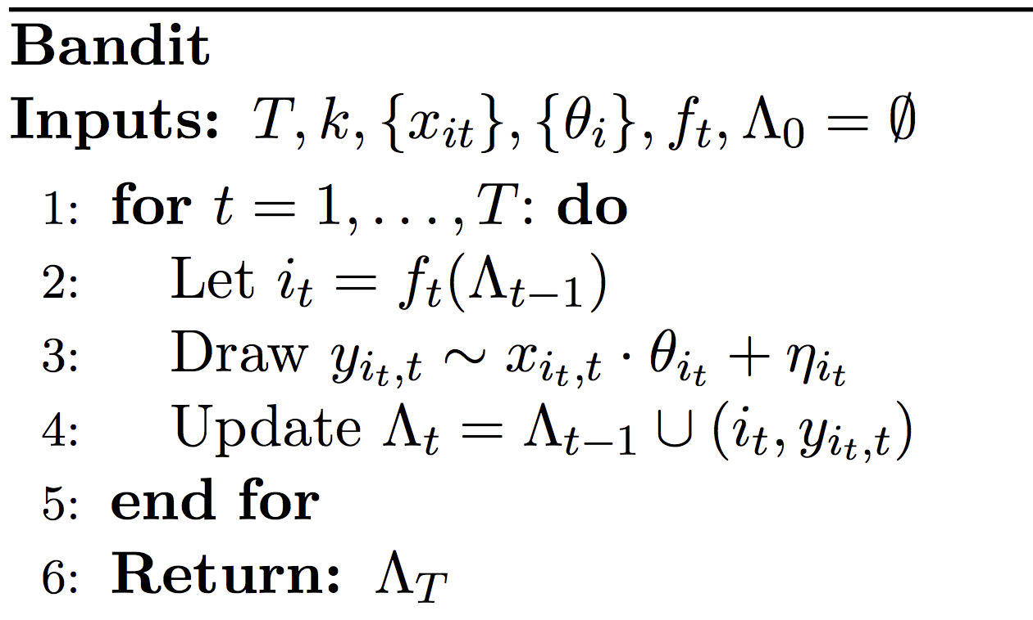
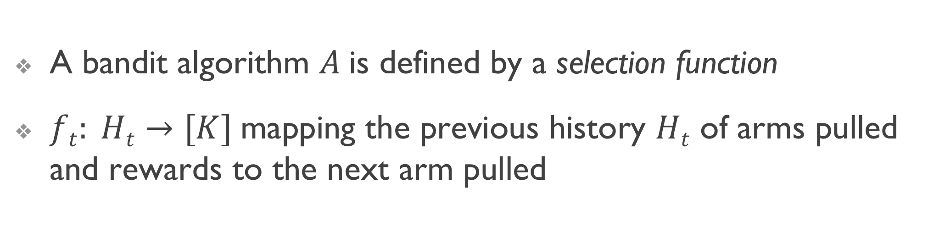
Bandit Algorithms: Definition 1
A bandit algorithm $A$is defined by a selection function
$ft: Ht→[K]$mapping the previous history $Ht$ of arms pulled and rewards to the next arm pulled

Slide 9
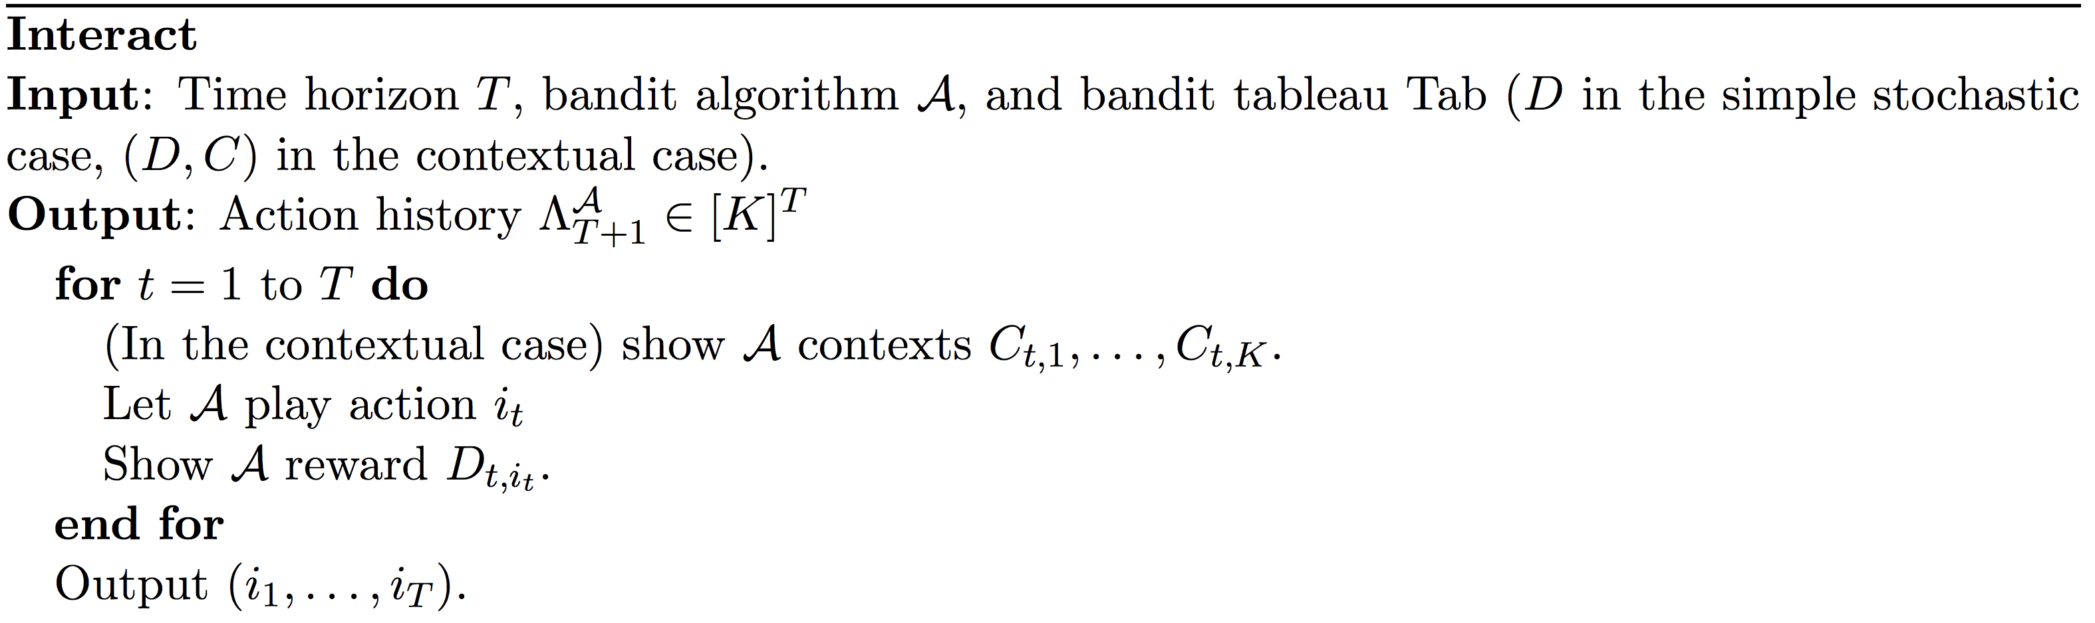
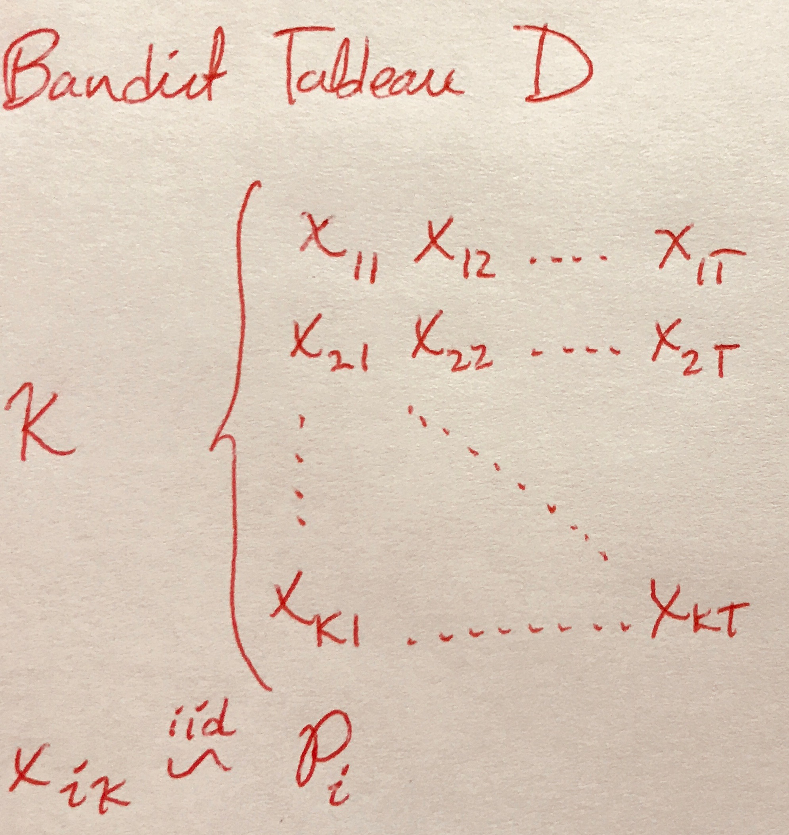
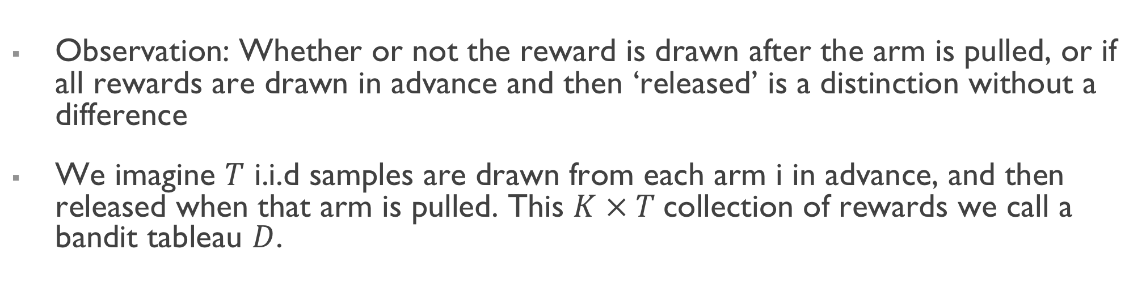
Bandit Algorithms: Definition 2
Observation: Whether or not the reward is drawn after the arm is pulled, or if all rewards are drawn in advance and then ‘released’ is a distinction without a difference
We imagine $T$ i.i.d samples are drawn from each arm i in advance, and then released when that arm is pulled. This $K × T$collection of rewards we call a bandit tableau $D$.

Slide 10

Bandit Differential Privacy
“Changing a single reward from an arm doesn’t change the probability of any event (in the space of pulled arms) by more than a multiplicative factor of e^{ε} or an additive factor of δ”

Slide 11

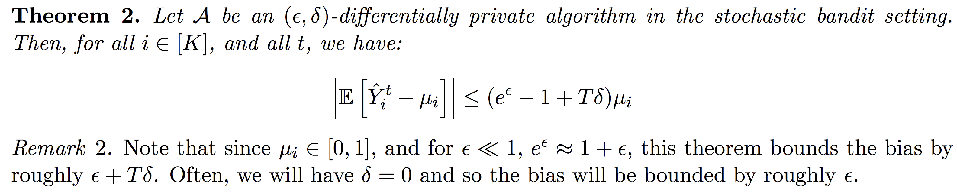
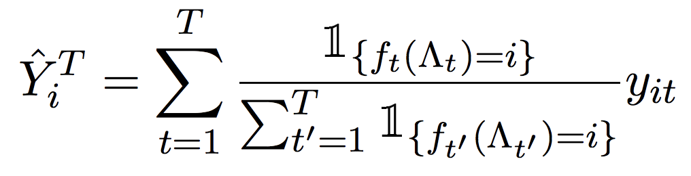
Privacy Bias Reduction
Proof Sketch:
Write down the random variable representing the sample mean at time T:

Slide 12
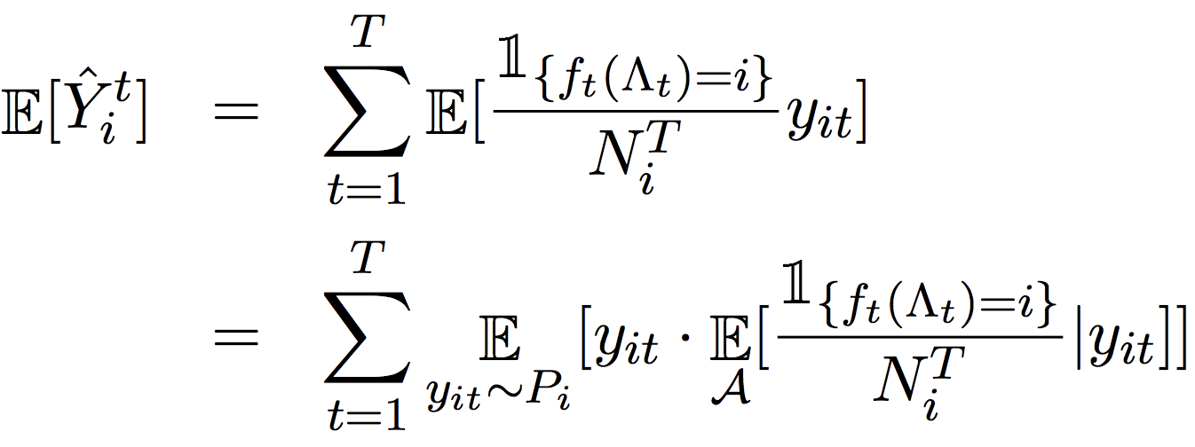
Continued..
The denominator is not independent of y_{it} – this dependence is the source of bias
Show that differential privacy bounds this bias, because the future choices of arm pull can’t depend too strongly on any individual reward (e.g. y_{it})

Slide 13
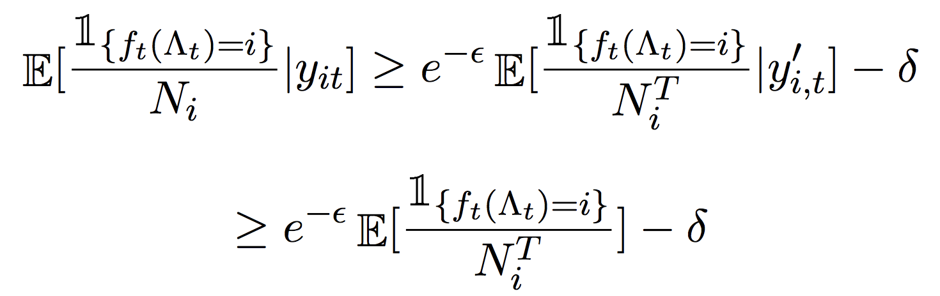
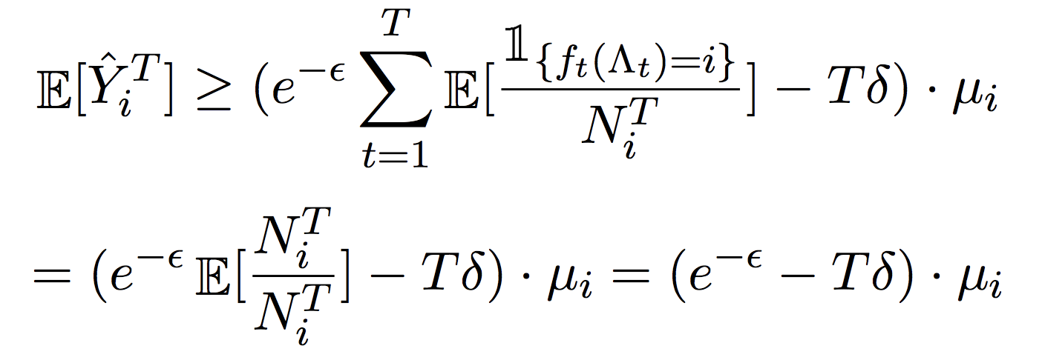
Continued..
Key statement (first line follows from (ε, δ) d.p. :
Subbing into the expression for the expectation gives:

Slide 14
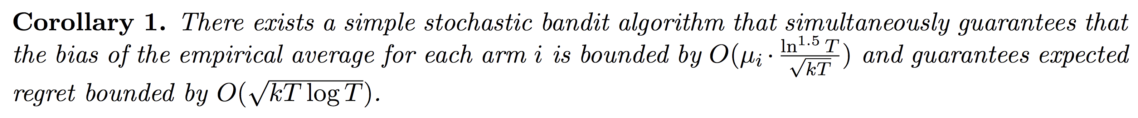
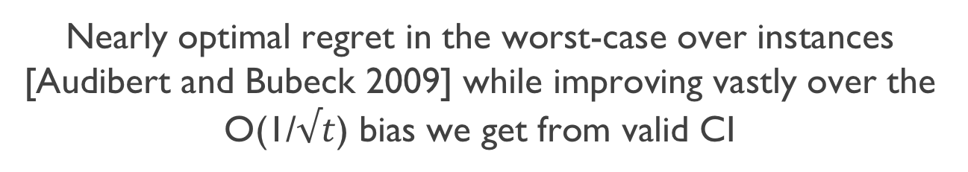
Balancing Accuracy and Bias
There exist differentially private algorithms that obtain a near optimal tradeoff between privacy and regret (see e.g. Tossou & Dimitrakakis 2016]
Applying the above theorem with their regret bounds gives:
Nearly optimal regret in the worst-case over instances [Audibert and Bubeck 2009] while improving vastly over the O(1/$√t$) bias we get from valid CI

Slide 15
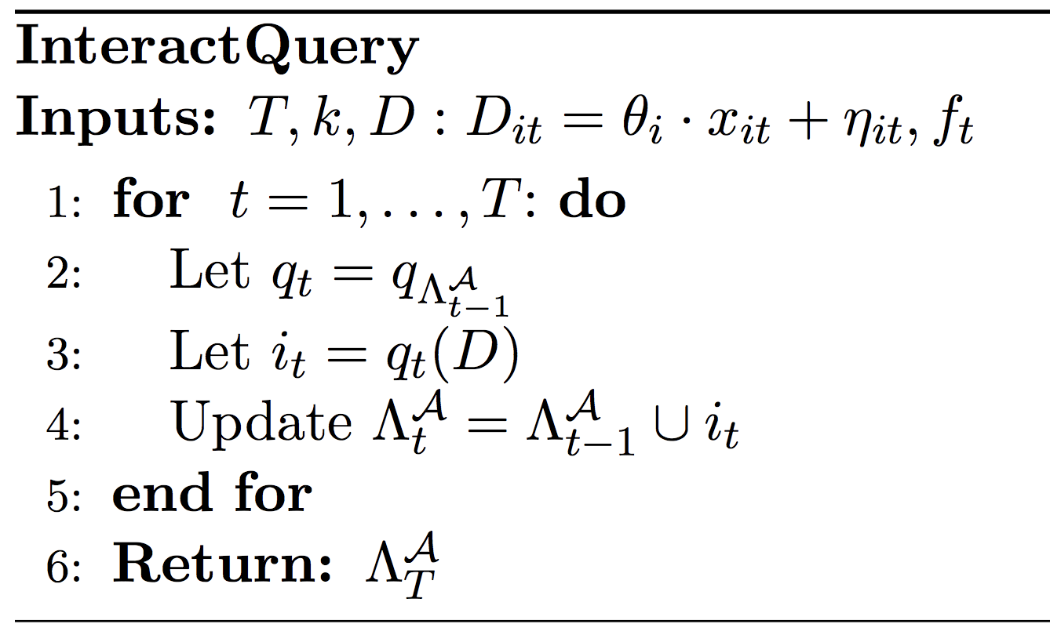

Bandit Algorithms as Query Release
Database is the bandit tableau D
The query at round t asks which arm to pull at round t+1 (is a function of the data)
Bandit algorithm can be modeled as a sequence of queries where q_{t} is only a function of the subset of D that has been “seen” by the algorithm
Hence all standard results in adaptive data analysis carry over!

Slide 16
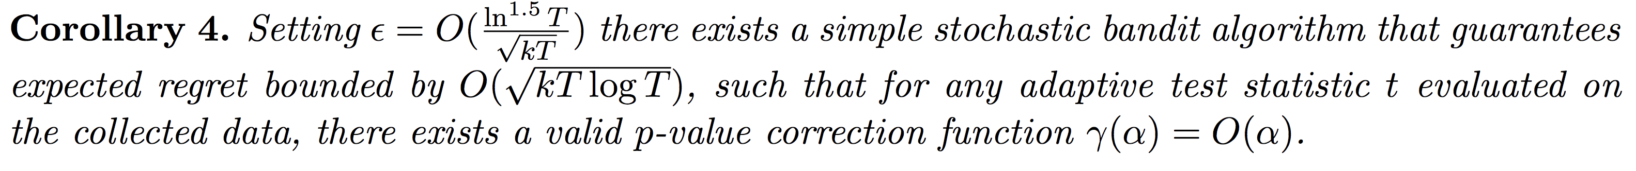

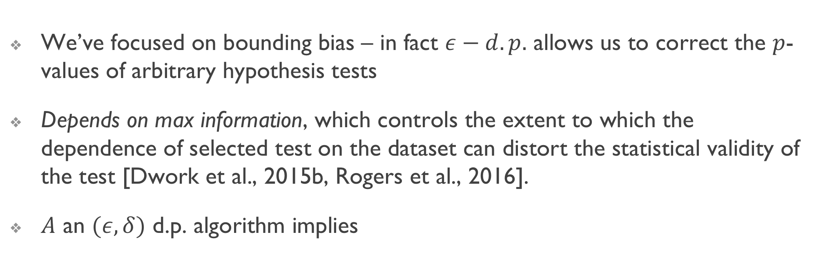
Max Information Bounds
We’ve focused on bounding bias – in fact $ε−d.p.$ allows us to correct the $p$-values of arbitrary hypothesis tests
Depends on max information, which controls the extent to which the dependence of selected test on the dataset can distort the statistical validity of the test [Dwork et al., 2015b, Rogers et al., 2016].
$A$ an $(ε, δ)$ d.p. algorithm implies
Previous results → constant factor $p$-value correction with near opt regret!

Slide 17
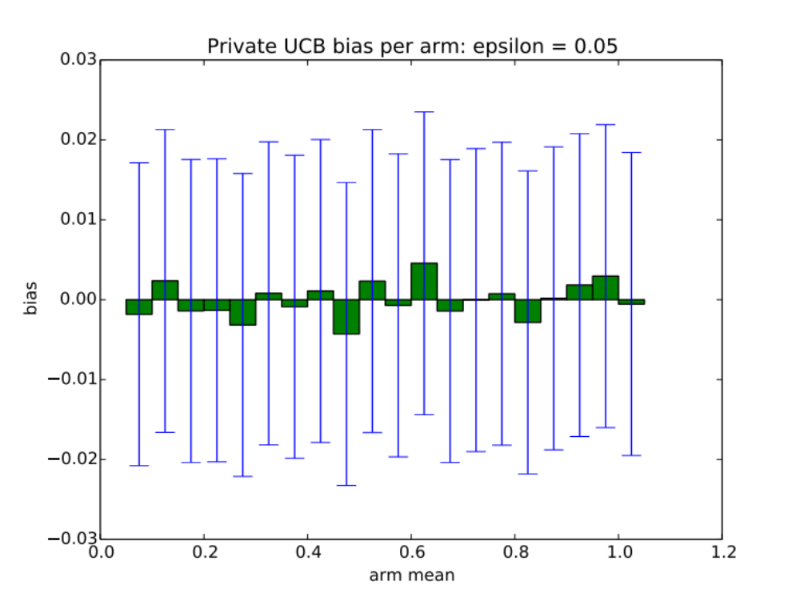
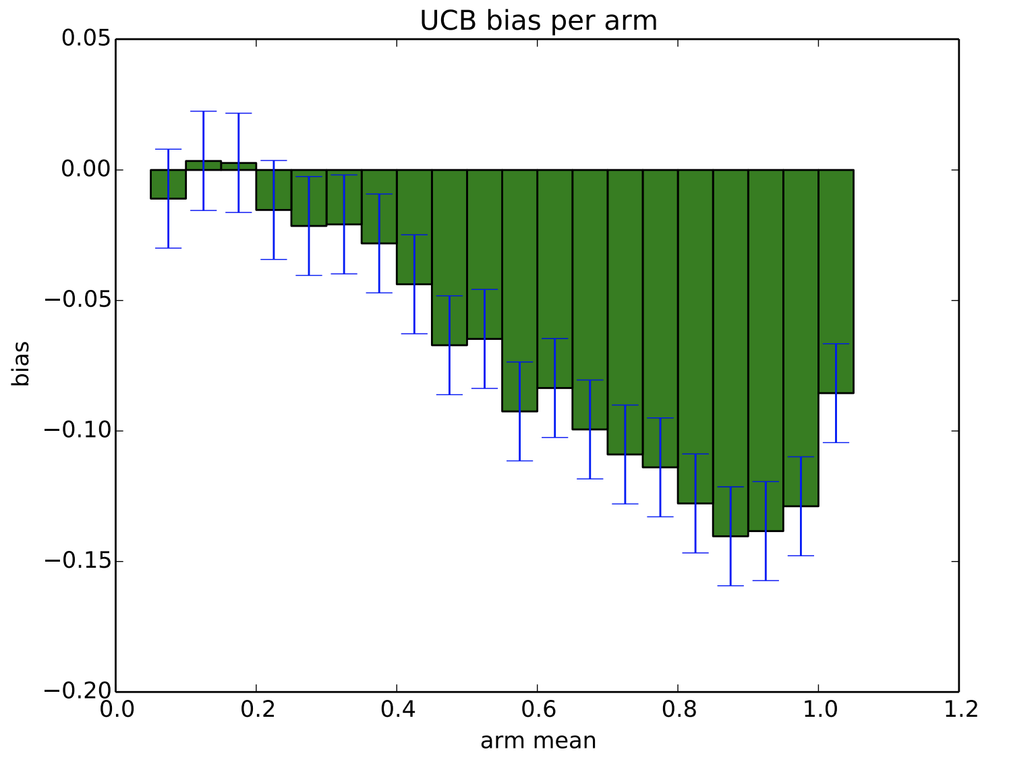
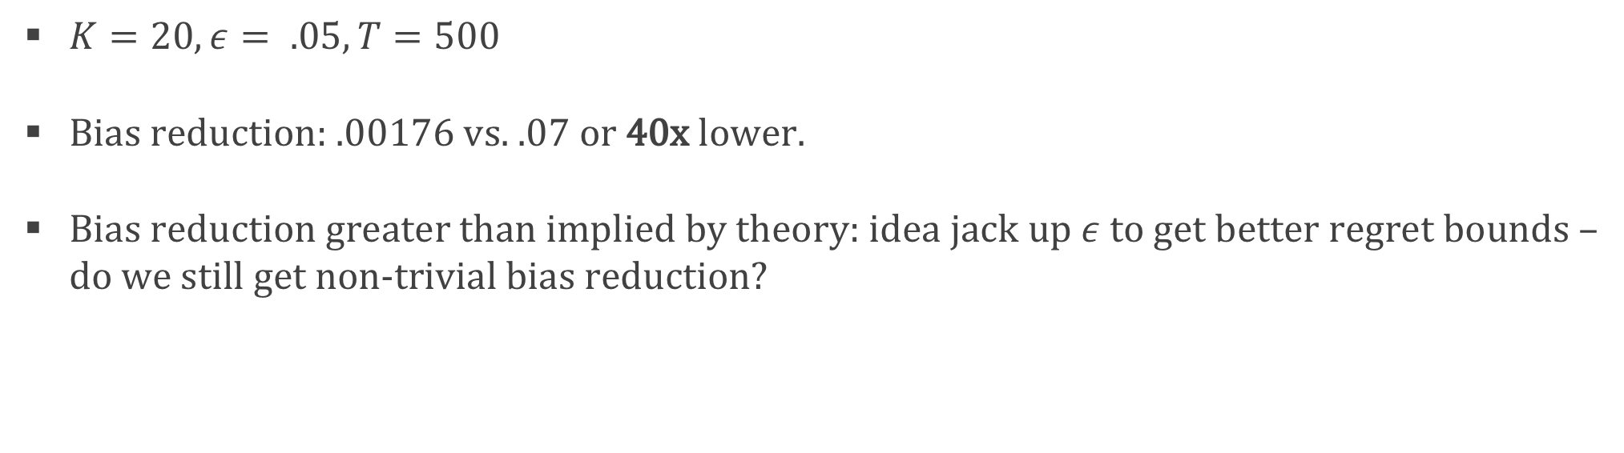
Experiments
$K=20, ε= .05, T=500$
Bias reduction: .00176 vs. .07 or 40x lower.
Bias reduction greater than implied by theory: idea jack up $ε$to get better regret bounds – do we still get non-trivial bias reduction?

Slide 18
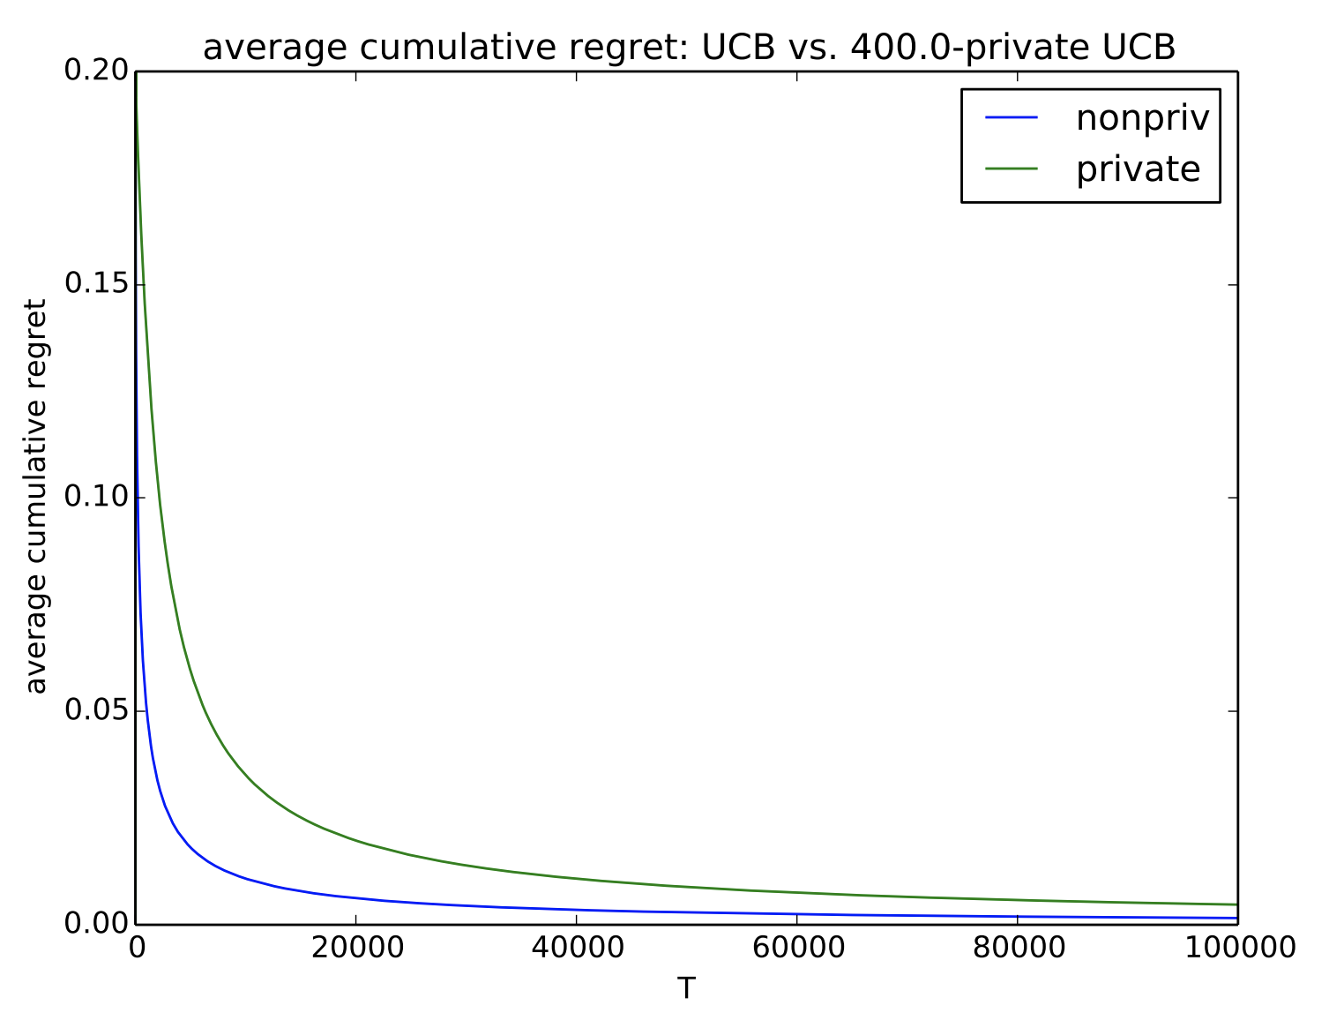
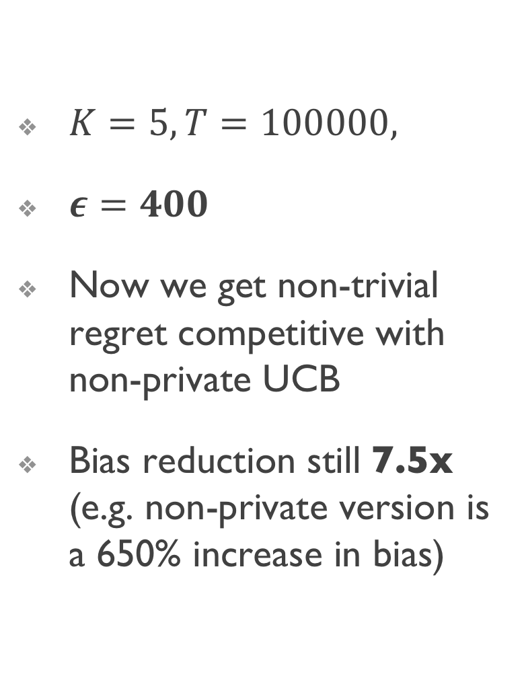
Experiment 2
$K=5, T=100000,$
$ε=400$
Now we get non-trivial regret competitive with non-private UCB
Bias reduction still 7.5x (e.g. non-private version is a 650% increase in bias)

Slide 19
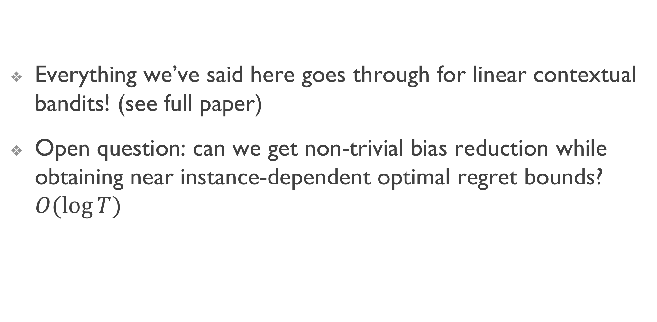
The End
Everything we’ve said here goes through for linear contextual bandits! (see full paper)
Open question: can we get non-trivial bias reduction while obtaining near instance-dependent optimal regret bounds? $O(log⁡T)$

Slide 20
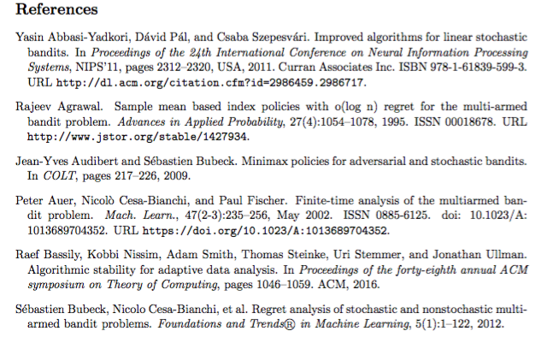
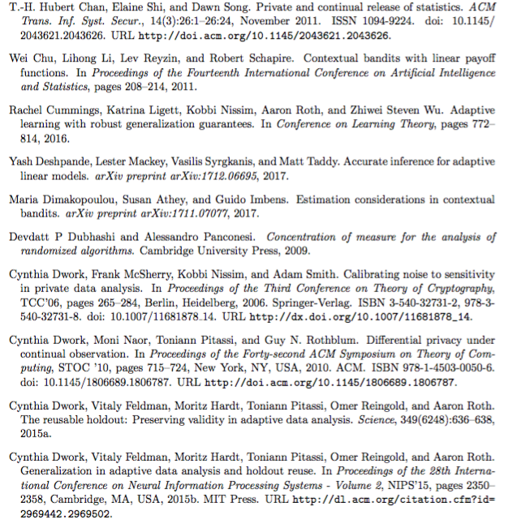
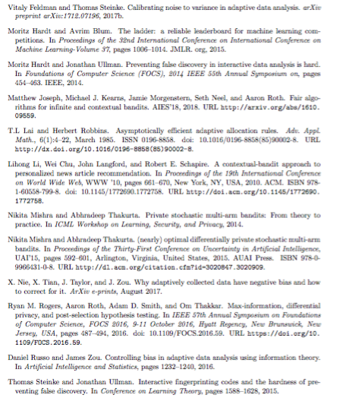
refs

