Slide 1
Preventing Fairness Gerrymandering: Auditing and Learning for Subgroup Fairness
Seth Neel
University of Pennsylvania
EC 2018: MD4SG Workshop
Cornell University
June 22, 2018
Joint work with Michael Kearns, Aaron Roth, and Steven Wu
To appear, ICML 2018
Pre-print available on arXiv

Slide 2
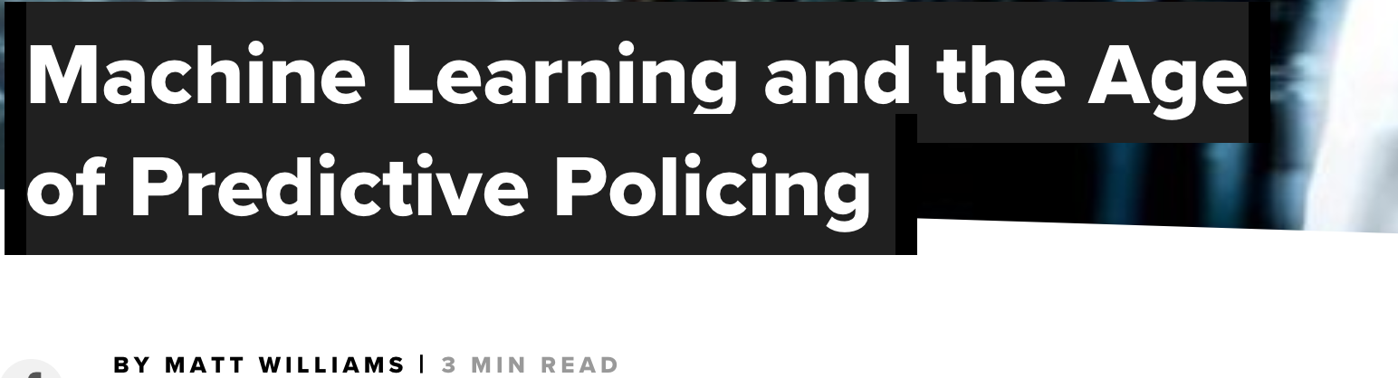
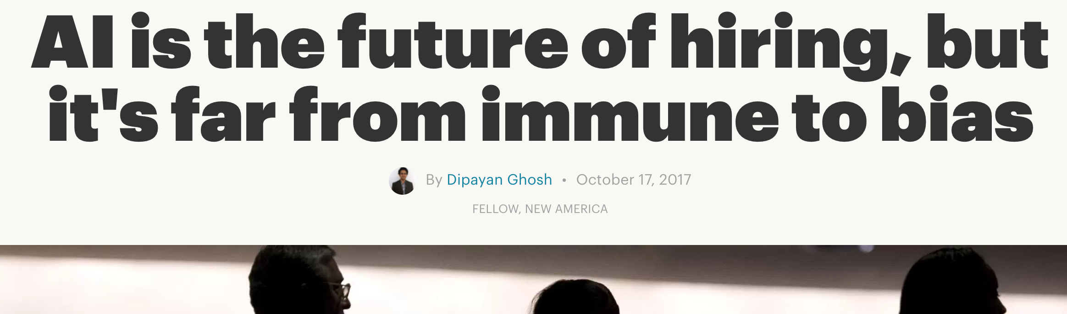
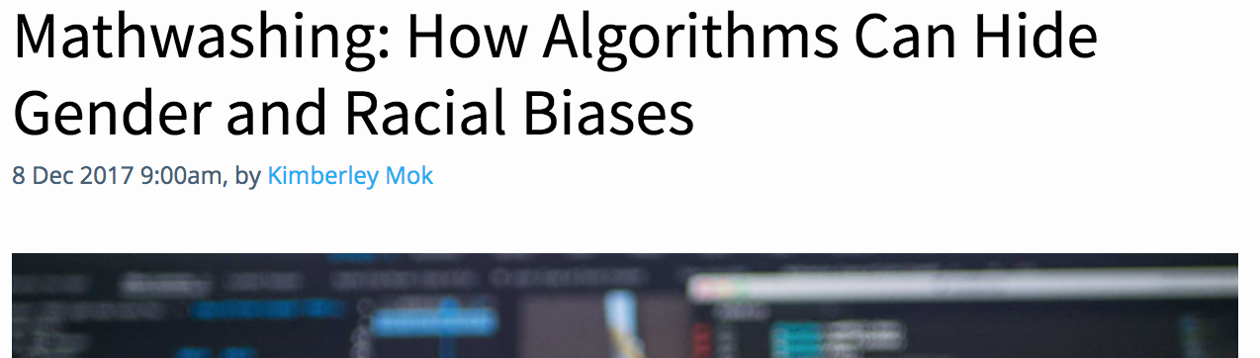
Discrimination & Machine Learning

Slide 3
Can we design fair ML algorithms?
What does fairness mean?

Slide 4
Statistical Fairness Notions
Protected groups defined by protected features (race, gender, age…)
  example of binary classification: giving out loans
  Statistical parity [Dwork et al. 2012]: equality of acceptance rates across groups
    (ignores creditworthiness)
  Equalized odds [Hardt et al. 2016]: equality of false positive, false negative rates across groups
    (accounts for creditworthiness)
  Calibration [Kleinberg et al. 2016]: equality of positive predictive values (PPV) across groups
    (PPV = Pr[ y = 1 | h(x) = 1 ])

Slide 5
Interpolating group fairness and individual fairness
Problem: achieving group fairness by subgroup discrimination
  e.g. "disabled Hispanic women over the age of 50" (conjunction)
  no reason to expect it won’t happen under standard fairness notions
But also “impossible" to protect arbitrary subgroups (individuals)
  Focus on computationally/statistically identifiable subgroups
  e.g. subgroups defined by conjunctions over protected features

Slide 6


Finer-Grained Subgroups?
No promises made to individuals or finer-grained subgroups
: accepted individuals
Blue
Green
Male
Female

Slide 7
Binary Classification Formulation
n samples (or individuals) (x, x’, y) ~ P; features x are “protected”
Model/Decision algorithm D makes prediction/decision D(x, x’)
g(x) is characteristic function of some subgroup:
  g(x) = 1 indicates (x, x’, y) belongs the subgroup g
G: rich but limited class of subgroups over protected features
  e.g. G = conjunctions, linear thresholds, decision lists,…

Slide 8
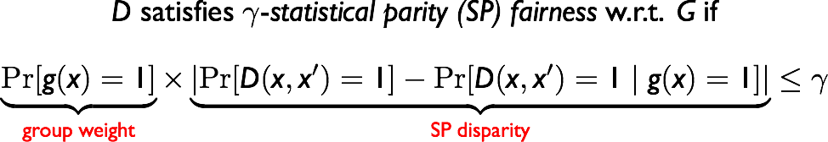
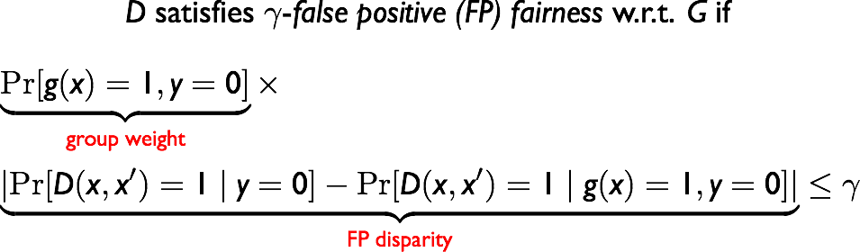
Statistical Fairness Notions
  VC dimension of G allows us to bound generalization error
  Related: [Hebert-Johnson et al. 2018] for calibration

Slide 9
Auditing and Learning
Auditing for γ-fairness w.r.t. G
  given access to samples (x, D(x, x’), y) induced by a black-box algorithm D, decide if D is γ-fair w.r.t. G, or output a violated g in the class G
Learning a classifier that is γ-fair w.r.t. G
  given a hypothesis class H over features (x, x’), find a distribution D over H that satisfies γ-fairness

Slide 10
Hardness of Auditing
Theorem (Informal): Auditing an arbitrary D for γ-(SP & FP) fairness w.r.t. G is computationally equivalent to weak agnostic learning of G.
Weak agnostic learning of G [Kearns et al. 1994; Kalai et al. 2008]:
given a dataset of (x, y) pairs drawn from P, whenever the best classifier in G has accuracy at least (1/2 + γ), find a function g in G with accuracy (1/2 + γ - ε), for some ε ≤ γ
The labels y are not promised to be generated by any g in G
Intuition: If g can predict the decisions D(x, x’) only using the protected features x, then D discriminates on the subgroup g

Slide 11
Bad News/Good News
  Bad news theoretically
  auditing even for simple structured classes G (e.g. conjunctions, half-spaces) is computationally intractable in the worst case
  learning over many classes of H (even without fairness constraint) is also NP-hard in the worst case
  Potentially good news in practice
  there exist powerful heuristics for agnostic learning/ERM problems
  SVM, logistic regressions, neural nets, boosting…

Slide 12
Learning for Subgroup Fairness
Goal: find the optimal fair (randomized) classifier in H
Main result: reduction to a sequence of CSC problems
(generalize [Agarwal et al. 2017] to many subgroups)
Key Idea: simulate a zero-sum game between an Auditor and a Learner

Slide 13
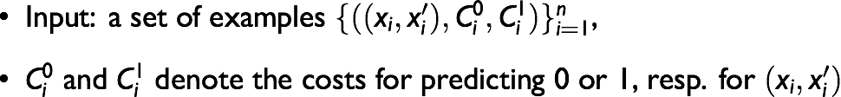
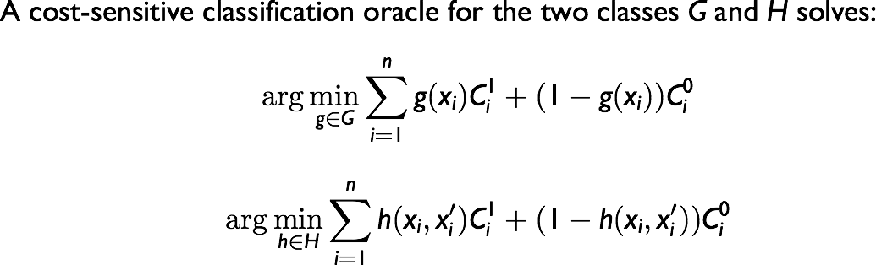
Cost-Sensitive Classification (CSC)
CSC problem is equivalent to agnostic learning
[Zadrozny et al. 2003]

Slide 14
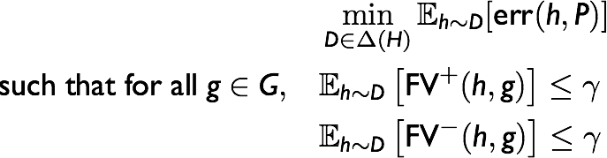
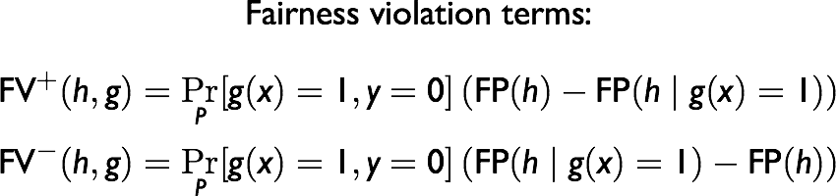
Fair Empirical Risk Minimization Problem
Let P be the empirical distribution over the n data points

Slide 15
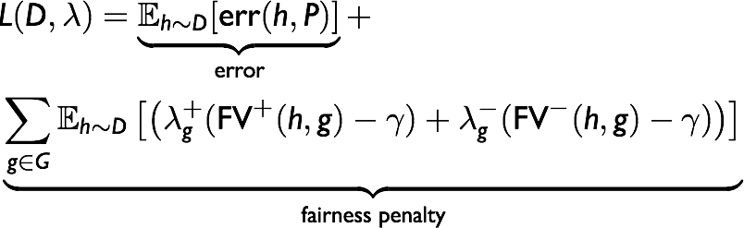
From Lagrangian to Zero-Sum Games
Optimal solution for fair ERM is the minimax equilibrium:
Learner controlling D v.s. Auditor controlling λ

Slide 16
Best Response as CSC
  Lemma: The best response for both the Learner and the Auditor can be computed by solving a cost-sensitive classification problem over H and G respectively.
How to compute the equilibrium by relying on the CSC oracles?

Slide 17
Equilibrium via No-Regret Dynamics
For rounds t = 1, 2, …
Learner plays a no-regret learning algorithm updating D
  (suffer cumulative loss which is “not much worse” than the cumulative loss of the best fixed classifier h)
Auditor plays the best-response against D of the current round
  Find the most violated group and put all of the weight on the corresponding dual variable
  Reduced to a cost-sensitive classification problem over G
Theorem [Freund & Shapire 96]: The average plays of the two players form an (approximate) equilibrium.

Slide 18
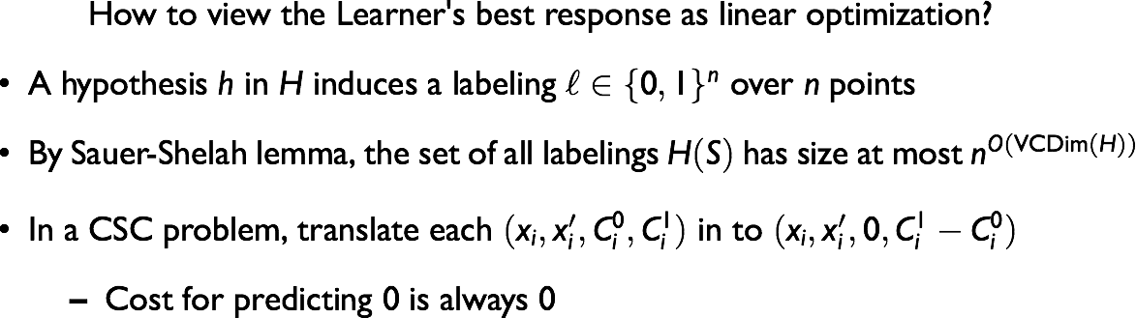
No-Regret Algorithm for the Learner
How to implement an oracle-efficient online learner?
Key idea: “Follow-the-Perturbed-Leader” for online linear optimization

Slide 19
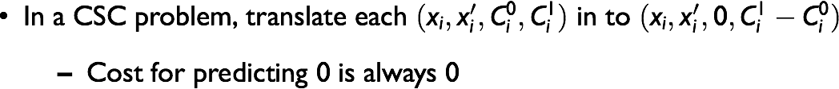
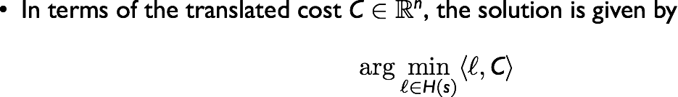
Turn CSC into Linear Optimization

Slide 20
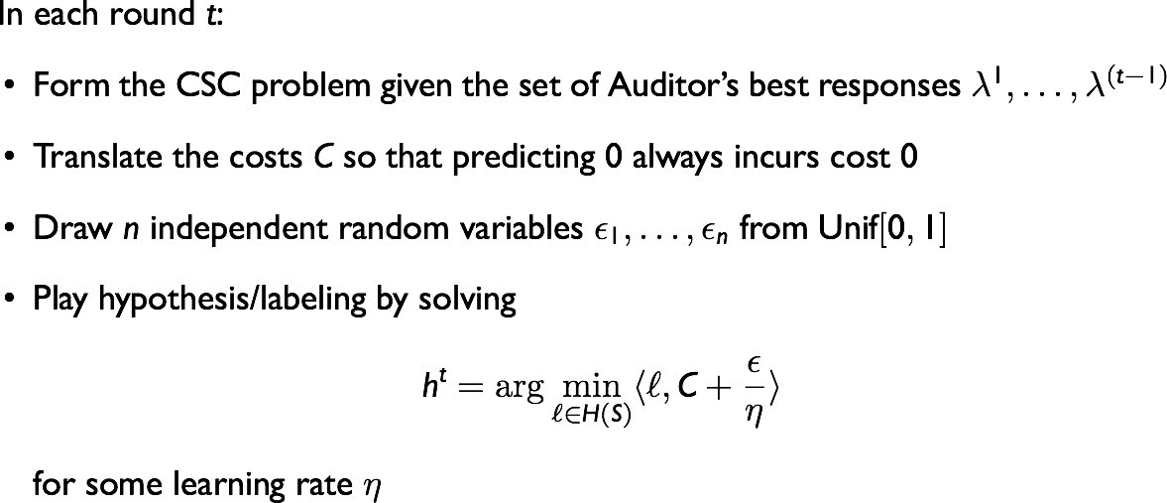
Follow the Perturbed Leader

Slide 21
Main Theoretical Result
Theorem (Informal): Given access to CSC oracles over classes of H and G, our algorithm runs in polynomial time, and outputs a randomized classifier D that is γ-free w.r.t. all groups in G.
Is this useful?

Slide 22
Empirical Evaluation
Solving the zero-sum game using Fictitious Play:
  Each player in each round plays best response against the opponent’s empirical play so far
  Avoids repeated sampling from FTPL distributions
  Only guarantees asymptotic convergence
  In practice has the merit of simplicity and faster per-step computation

Slide 23
Dataset
Communities and Crime dataset:
  census and other data on 2K U.S. communities
  target prediction: high vs. low violent crime rate
  122 features total; 18 protected (racial groups, incomes, police)
Both H (d = 122) and G (d = 18) are linear threshold functions
Implemented with thresholded linear regression as CSC oracle

Slide 24
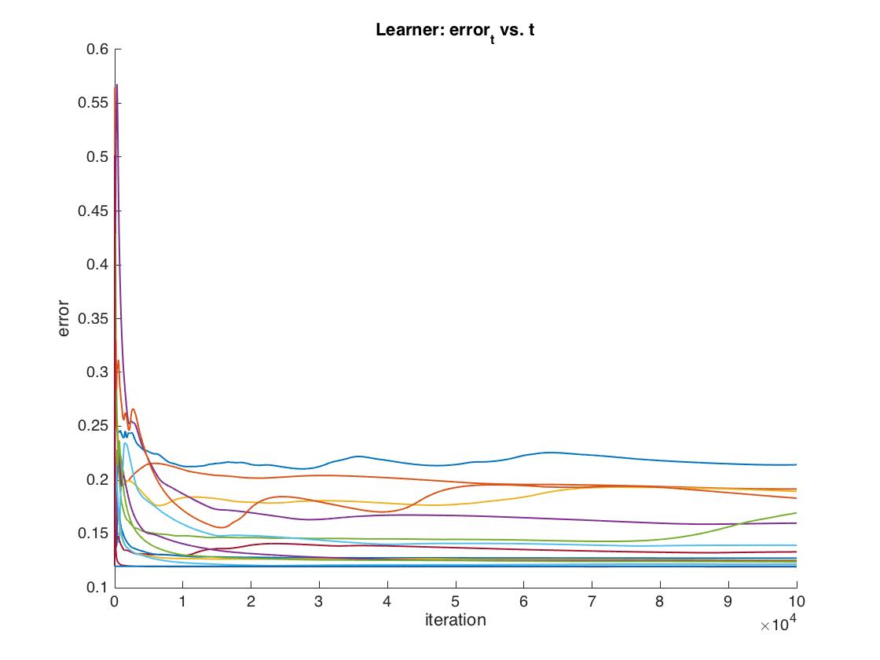
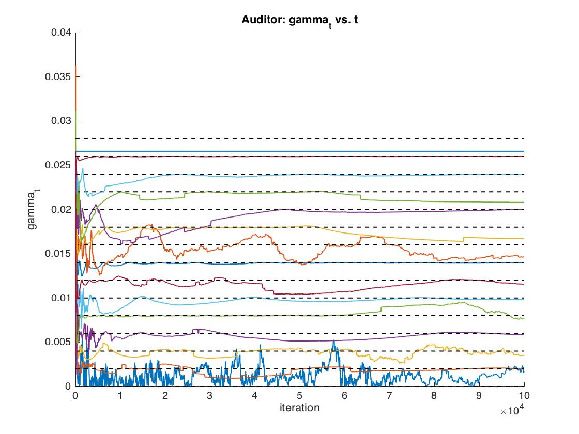
Convergence for different input γ’s

Slide 25
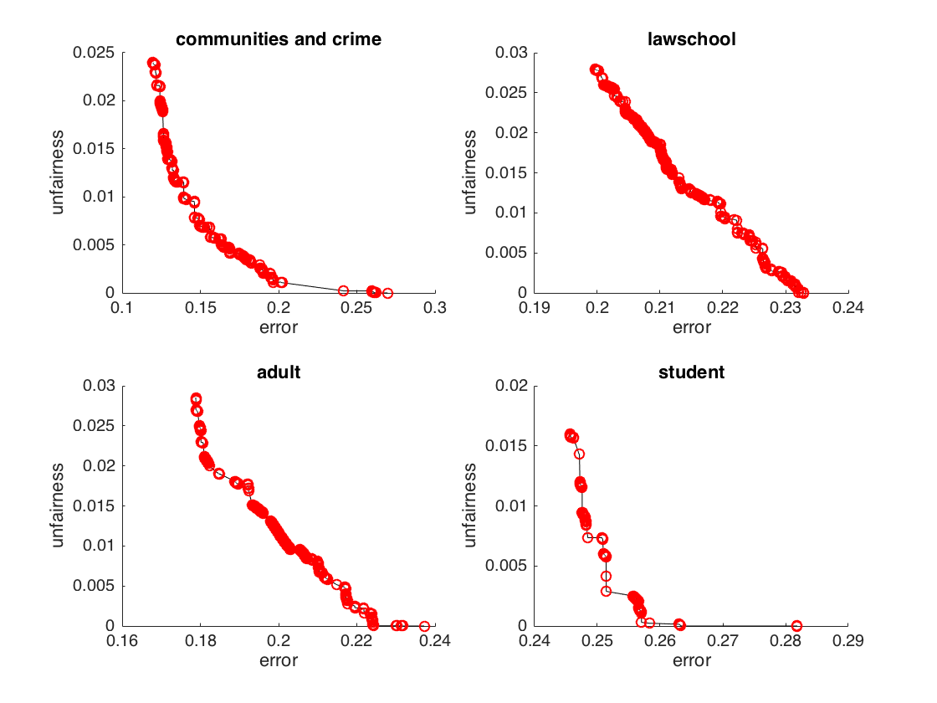
Pareto Curves: (error, γ)
      Across a range of datasets unfairness starts around .02-.03
    We are able to drive near 0 with only a 3-6% increase in error

Slide 26
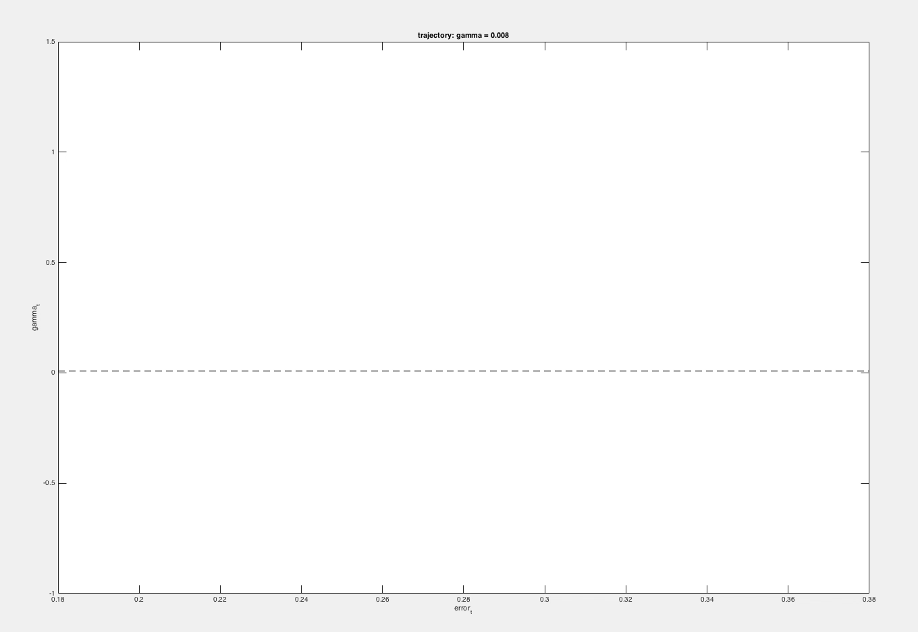

Slide 27
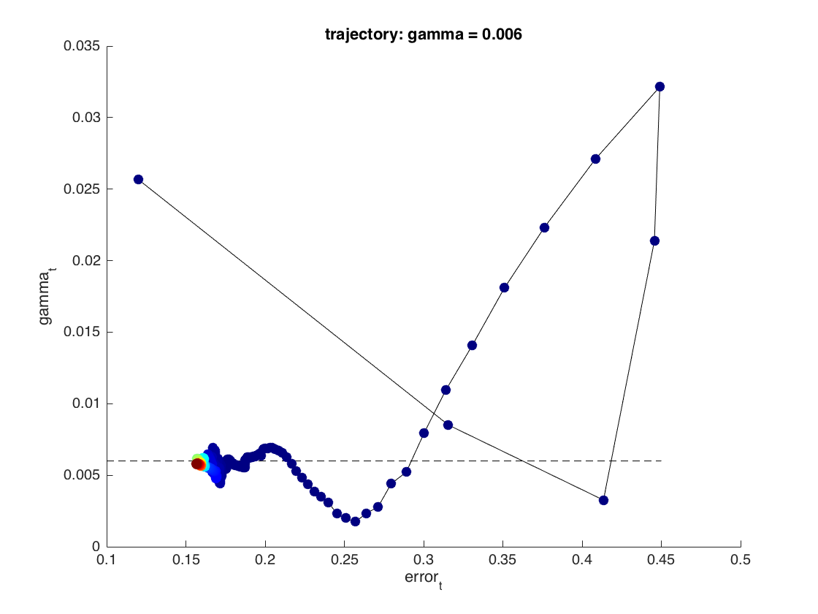

Slide 28
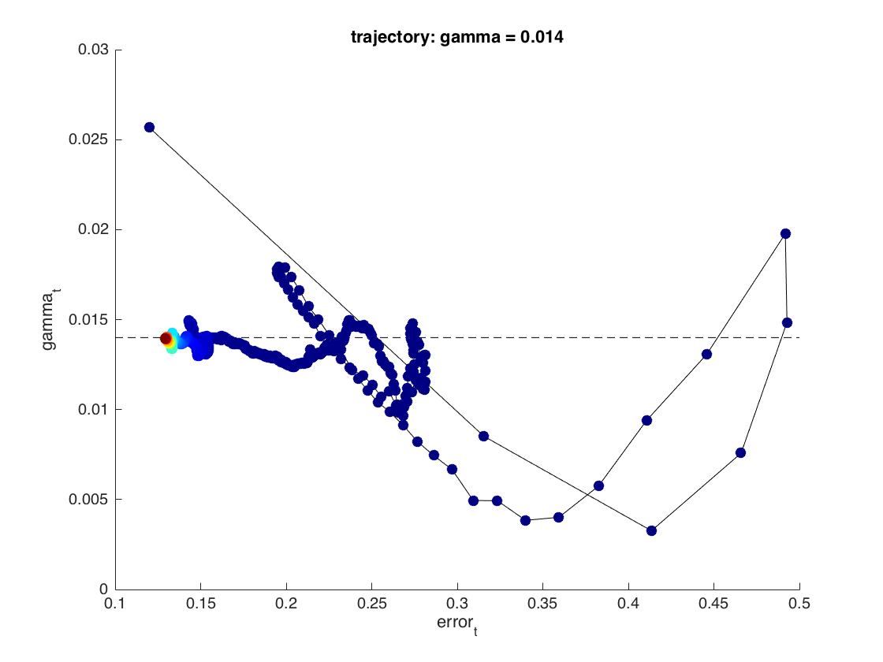

Slide 29
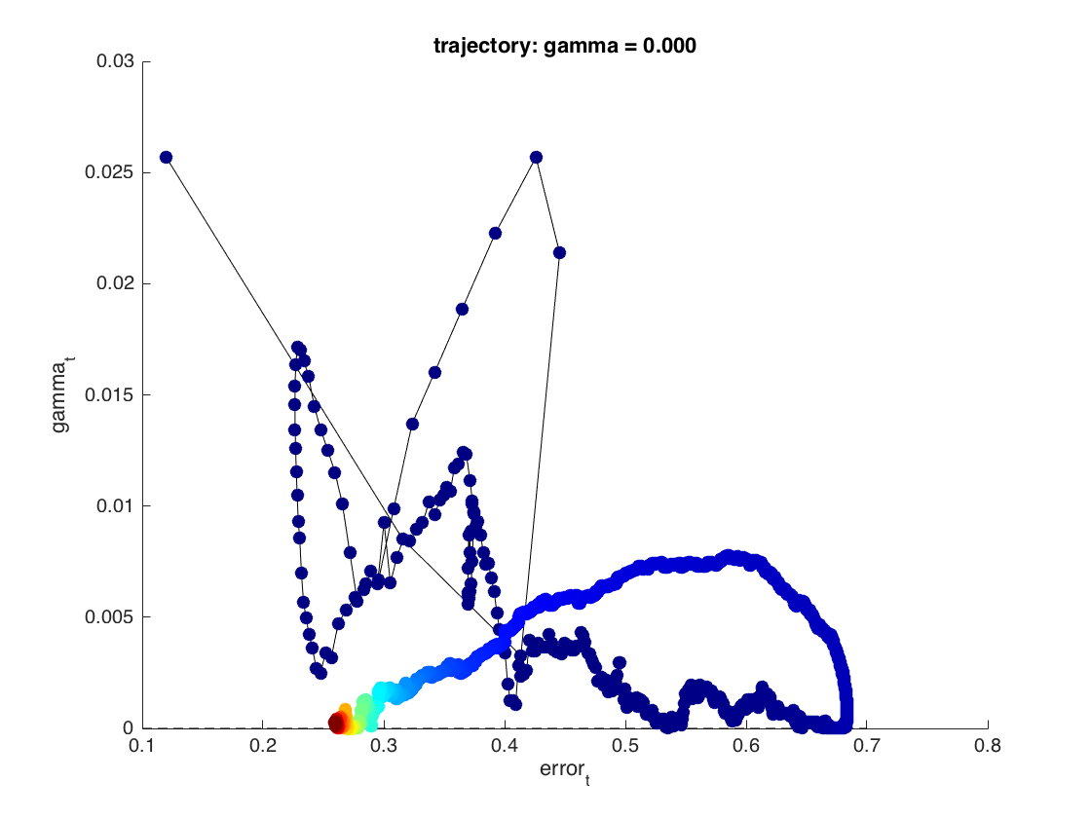

Slide 30
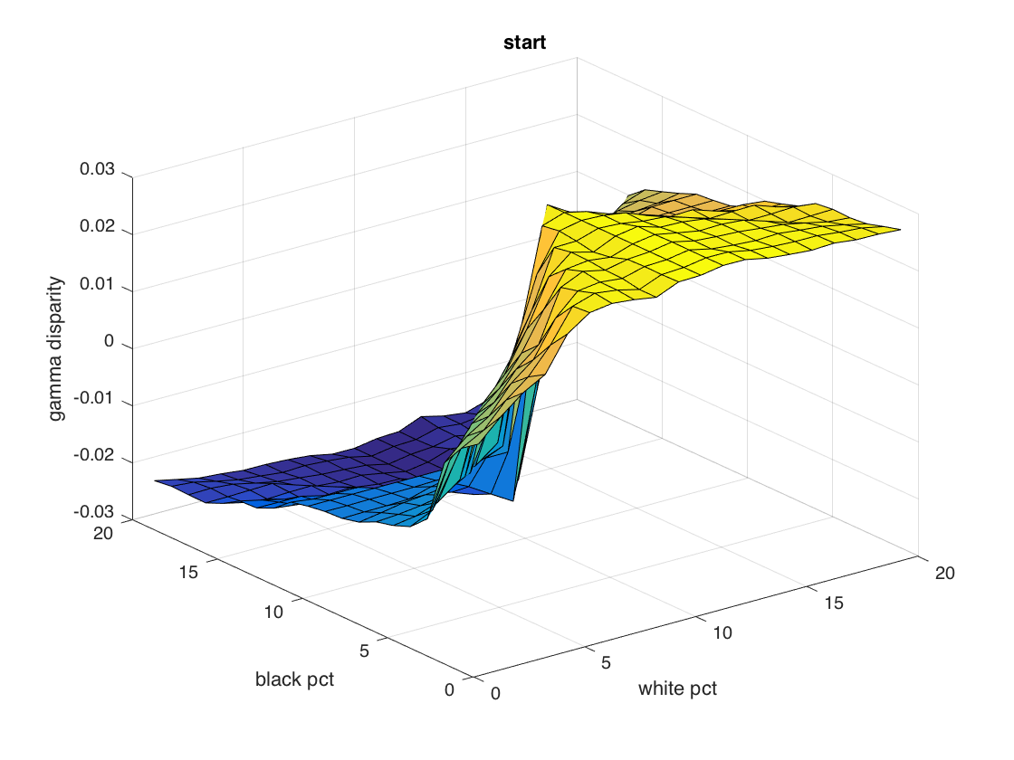
Flattening the Discrimination Heatmap

Slide 31
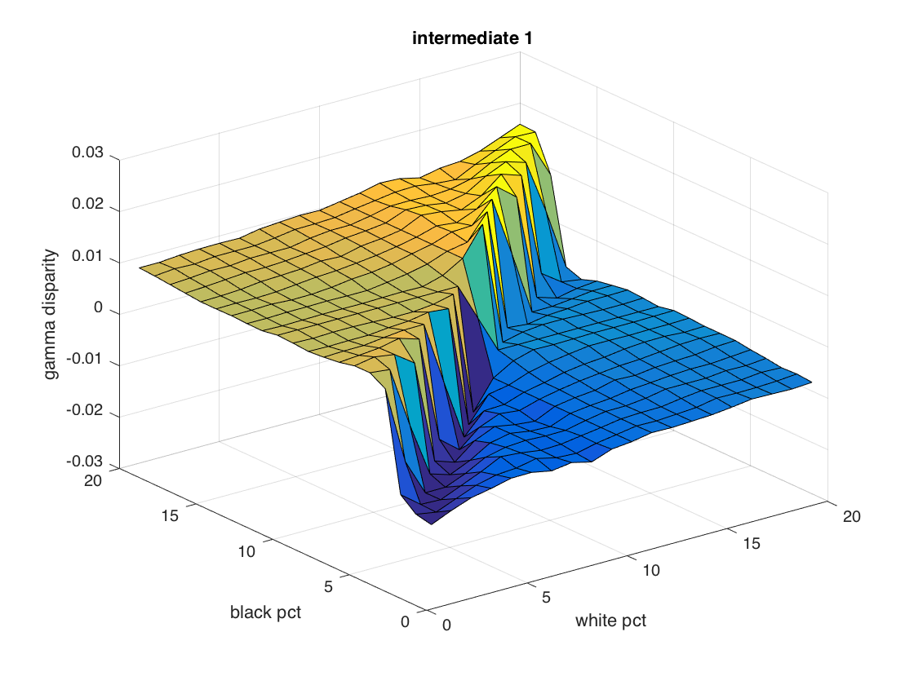

Slide 32
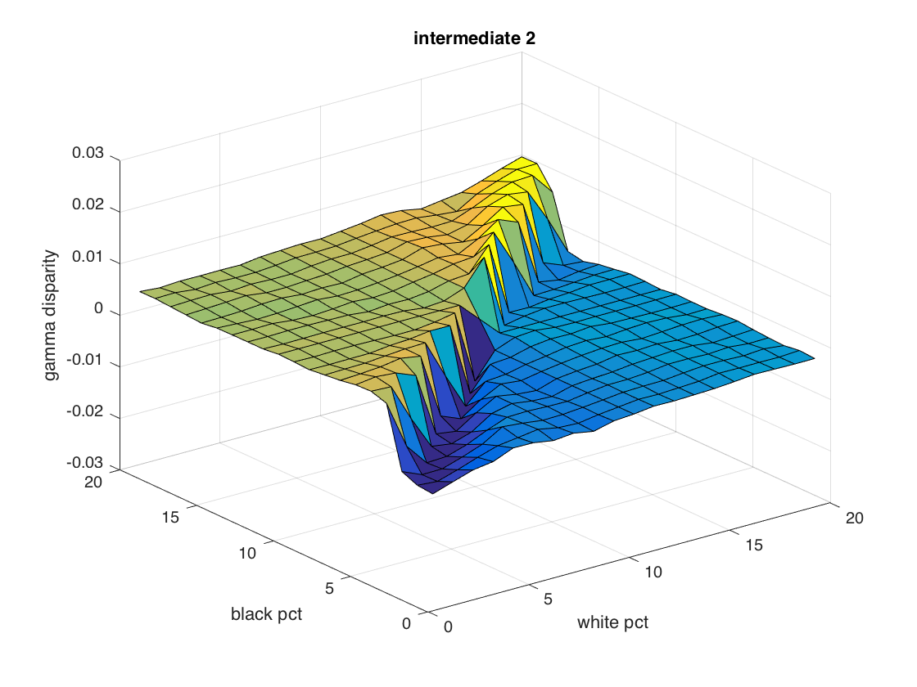

Slide 33
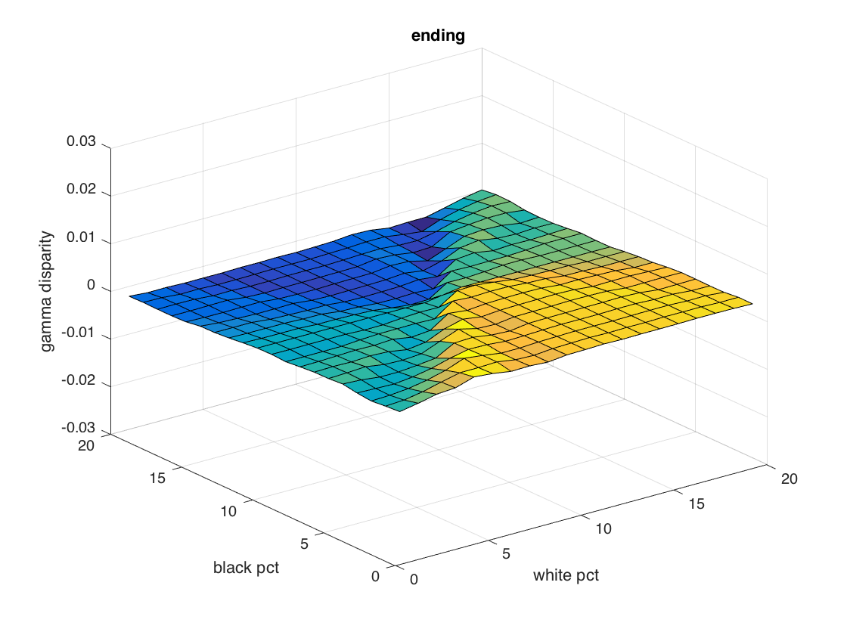
Subgroup Fairness!

Slide 34
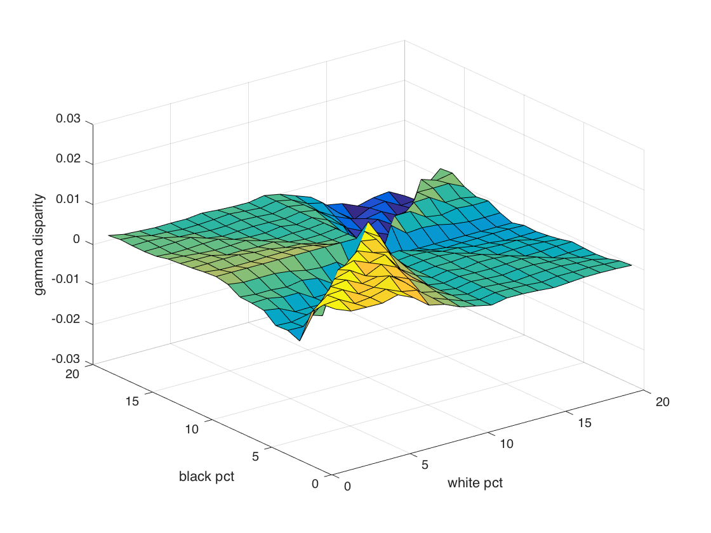
Does fairness to marginal subgroups achieve finer subgroup fairness? No!

Slide 35
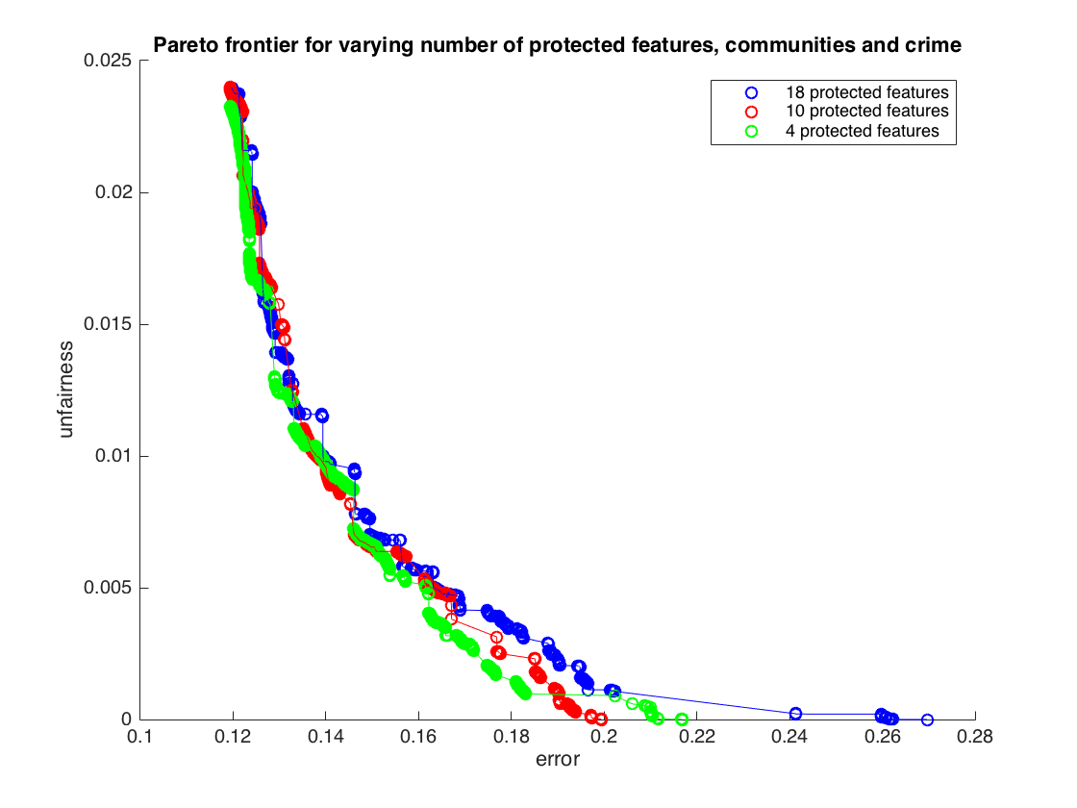
Pareto curve for (error, γ): varying the features

Slide 36
Preventing Fairness Gerrymandering: Auditing and Learning for Subgroup Fairness
Seth Neel
University of Pennsylvania
MD4SG
Cornell University
June 22, 2018
Joint work with Michael Kearns, Aaron Roth, and Steven Wu
To appear, ICML 2018
Pre-print available on arXiv

